Slide 1
2023 County Accomplishments

Slide 2
2023
A year of laying the foundation for generational change within our community

Slide 3
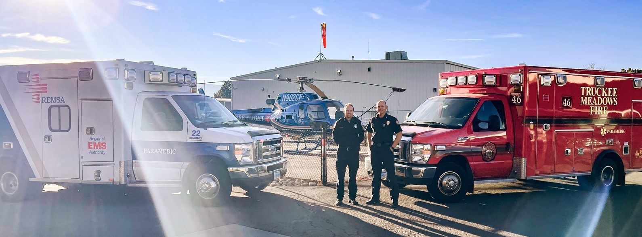
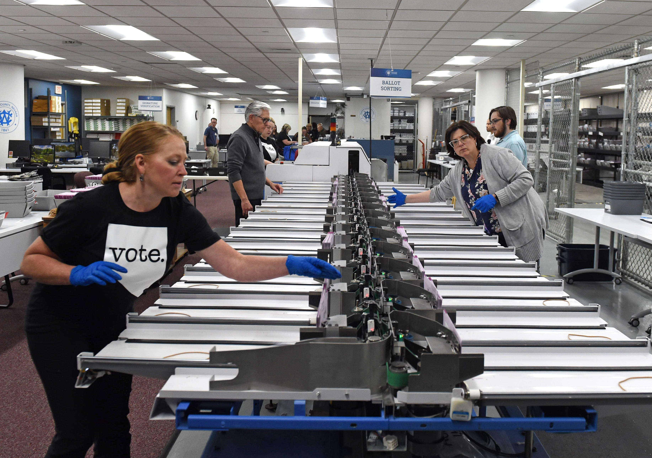
2023 Accomplishments
Regionalization of Dispatch/EMS/Fire
Executed regionalized computer aided dispatch (CAD) platform ILA with Reno/Sparks/REMSA in September
CAD implementation underway for target 24-month timeline
Improve Elections Administration/Execution
Completed independent consultant review of ROV 2022 elections operations
Implemented full staffing consistent with consultant recommendations
Standard Operating Procedure (SOP) development underway for PPP
Launched Climate Resilience Initiative
Hired Sustainability Manager
Award-Winning Green Recovery Plan
Secured sustainability federal grant for Gerlach
Envision Washoe 2040 Master Plan Update
Approved at the January Planning Commission meeting

Slide 4
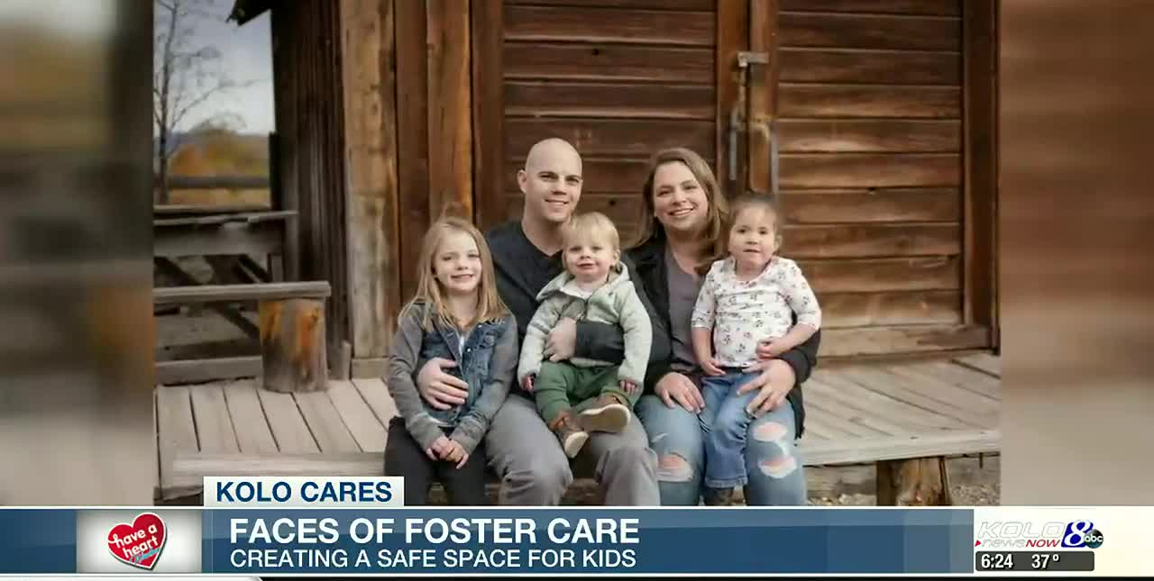
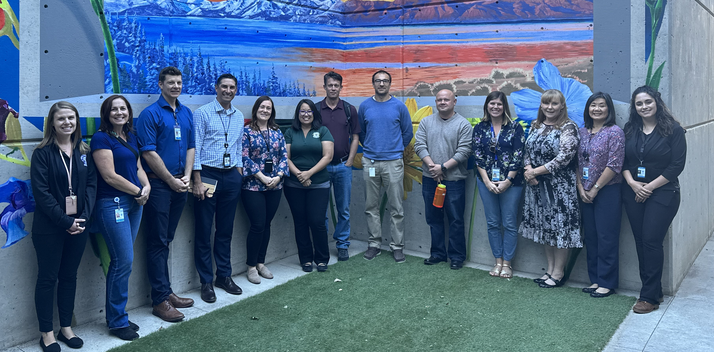
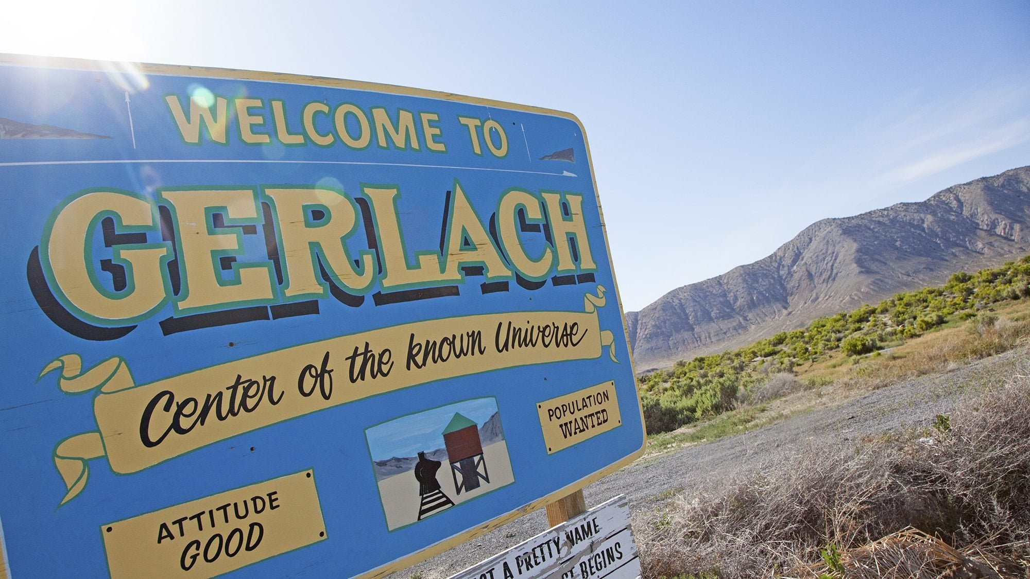
2023 Accomplishments
Initiated $1.8 million in improvements to the Senior Centers; work to be completed by end of summer of 2024
Increased childcare capacity by 250 children for foster families and County employee families
“Perimeter” emergency evacuation mapping tool
Completed the implementation of Gerlach broadband enabling high speed internet for the community
Notes:
When speaking, narrate the impact on the community so the impact is felt in the room.

Slide 5
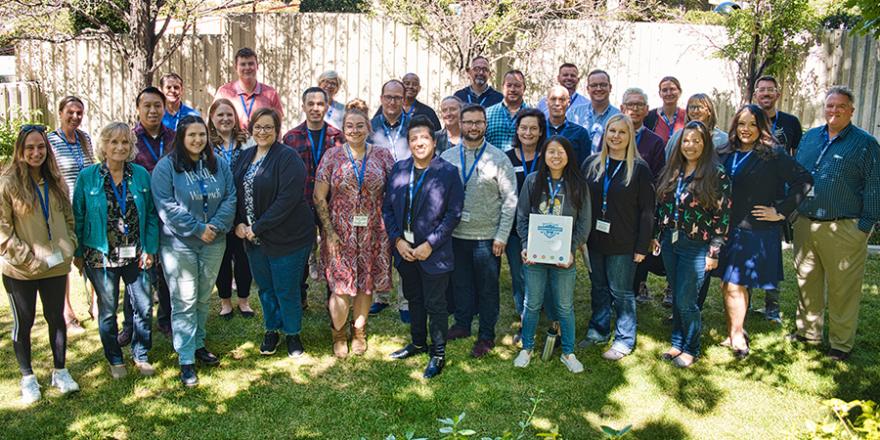
Expanded Outreach Initiatives
Washoe County Leadership Academy – Inaugural class complete and 2nd year underway
Received 267 applications in year two, up from 180 in year one
Increased curriculum by one full day, from 8 to 9 days
Nine first-year alumni applications to boards and committees, with five appointed; one new hire
Two class projects successfully completed in year one, with a single project focused on foster and adoption
Conducted 99 public meetings (including CABs) Resolved 280 commissioner requests
Notes:
Narrate here – the "why" is critical.

Slide 6
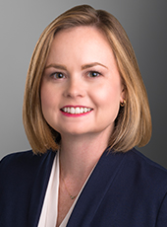
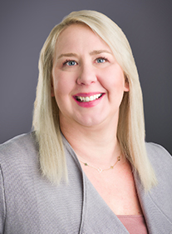
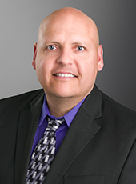
New Leadership Hired
Government Affairs Liaison
Public Defender
Alternate Public Defender
Director, Human Services Agency
Sustainability Manager
Registrar of Voters Staffing
Conflict Counsel Administrator
Notes:
These new employees have enabled the County to reach new heights – CPACE, more streamlined recruitment for B&C, more activity at the legislature, etc.

Slide 7
Strong Financial Management
Clean independent financial statement audit and compliance
Ended fiscal year 2023 with better-than-anticipated General Fund financial results
Award-winning accounting, financial reporting and budgeting
Expenditures continue to be less than budget
Accounting and Budget Management

Slide 8
Community Reinvestment Funding
Federal Funds Management
ARPA
ARPA-SLFRF | $91,587,038 | Grant Management | Funds Received
ARPA-LATCF | $9,427,223 | Grant Management | Funds Received
Appropriations FFY24
Bailey Creek Stormwater Management | $1,932,000 | Grant Management | Awarded-Pending Federal Budget Approval
WCSO – Rapid DNA Program | $996,300 | Grant Management | Awarded-Pending Federal Budget Approval
Appropriations FFY23
Lemmon Valley Heppner 5 Stormwater | $2,700,000 | Application to Congress | Awarded – Funding Available
Appropriations FFY22
CPF-Cares | $12,000,000 | Grant Management | Awarded – Funding Available
CPF-WCSO Infirmary | $2,335,000 | Grant Management | Awarded– Funding Available
Total | $118,876,071

Slide 9
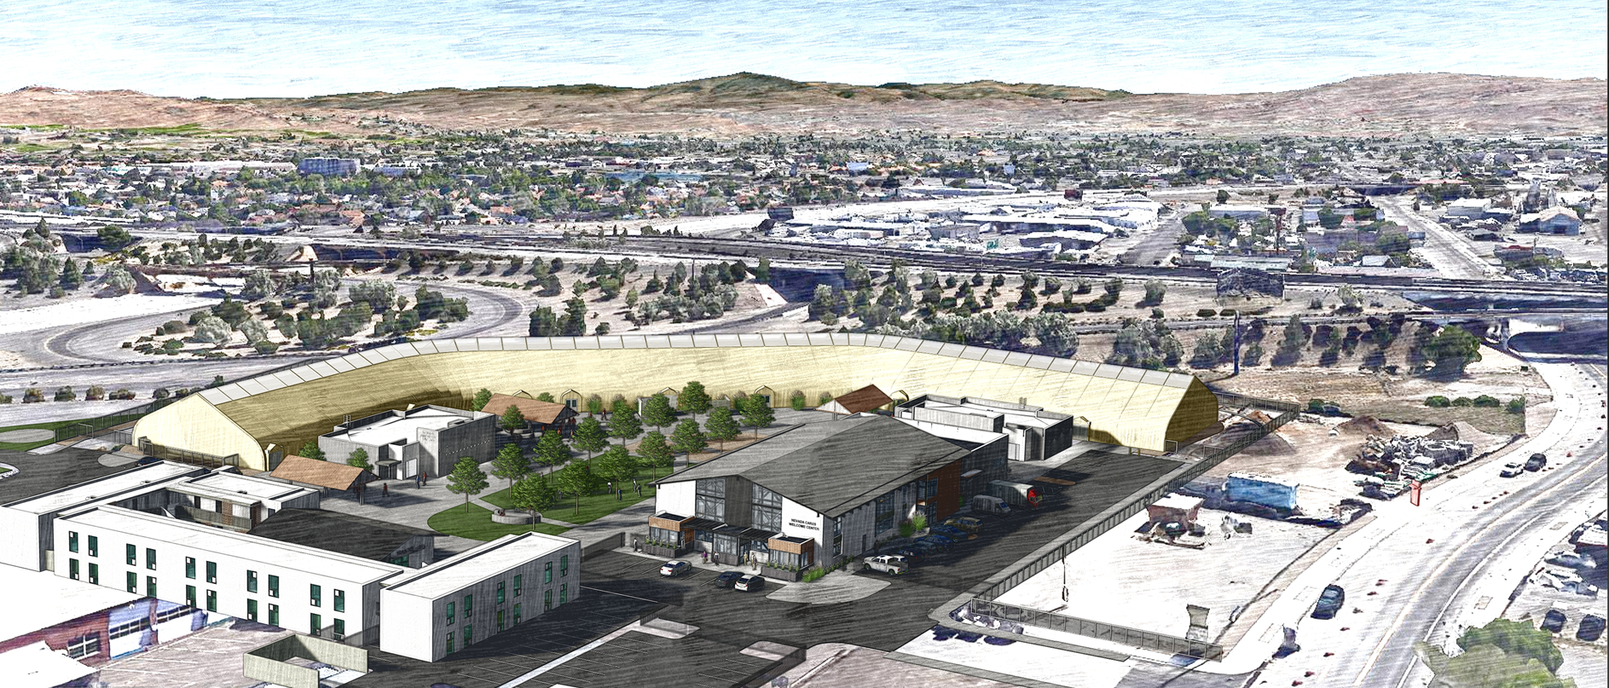
Housing and Homeless Services

Slide 10
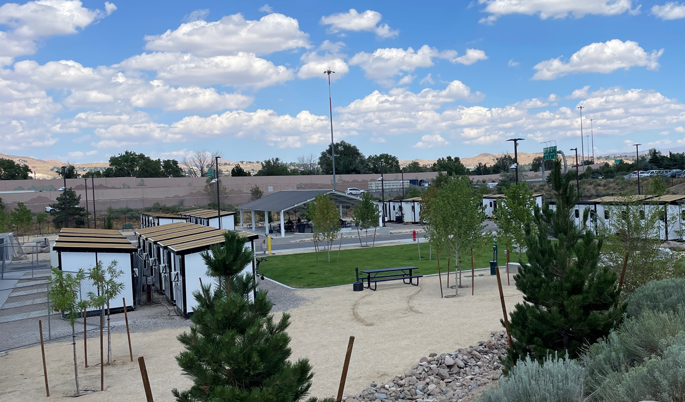
Serving Our Vulnerable Populations
Over the past year, the Nevada Cares Campus and Our Place permanently housed 486 single adults and 35 families
Launched a regional dashboard on washoecounty.gov to display current data and available shelter bed counts
Completed the Cares Campus Safe Camp pilot program and opened the permanent site
Completed and opened the Cares Campus Resource Center and Emergency Overflow Center (84 beds)
Secured $21.9 million to build Supportive Housing on the Cares Campus through Home Means Nevada and broke ground on the project
Community generated $6.5 million in private investment in Cares Campus
Permanent Supportive Housing
50-unit project under construction on Cares Campus
December BCC presentation on affordable housing incentives
Lease agreement with ASI for 120 units
$2 million in Affordable Housing Trust Fund
Housing and Homeless Services

Slide 11
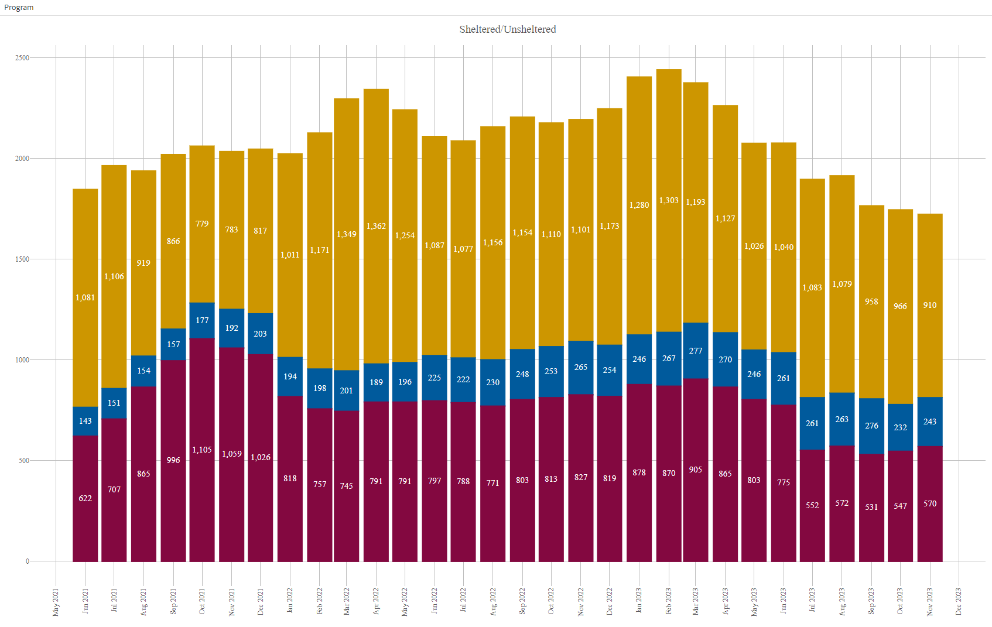
Regional Dashboard – Sheltered / Unsheltered
Emergency Shelter
Sheltered
Unsheltered

Slide 12
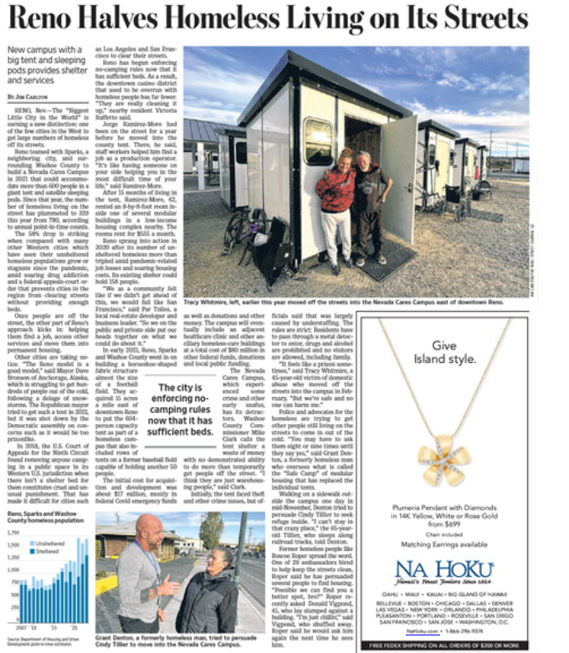
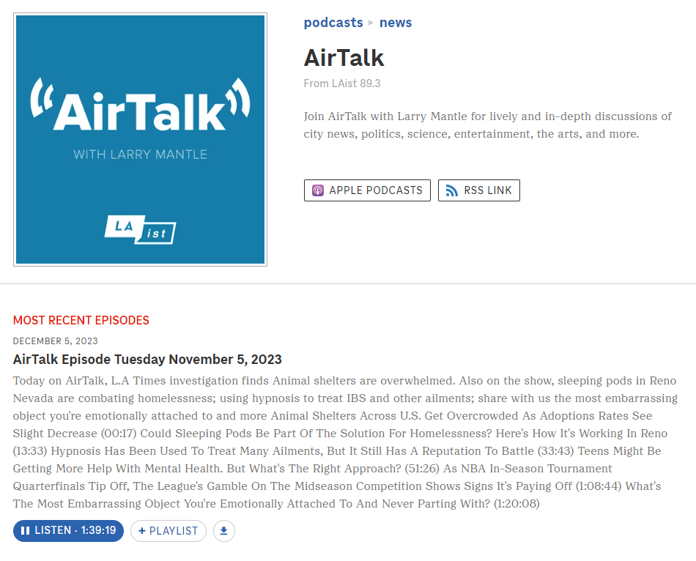
National Media Attention
“New campus with a big tent and sleeping pods provides shelter and services”
“the city is enforcing no-camping rules now that has sufficient beds.”
“Reno Nevada has undertaken a model which is getting praise and in fact, getting notice from other western cities.”
“Reno is beating the odds in solving homelessness”

Slide 13
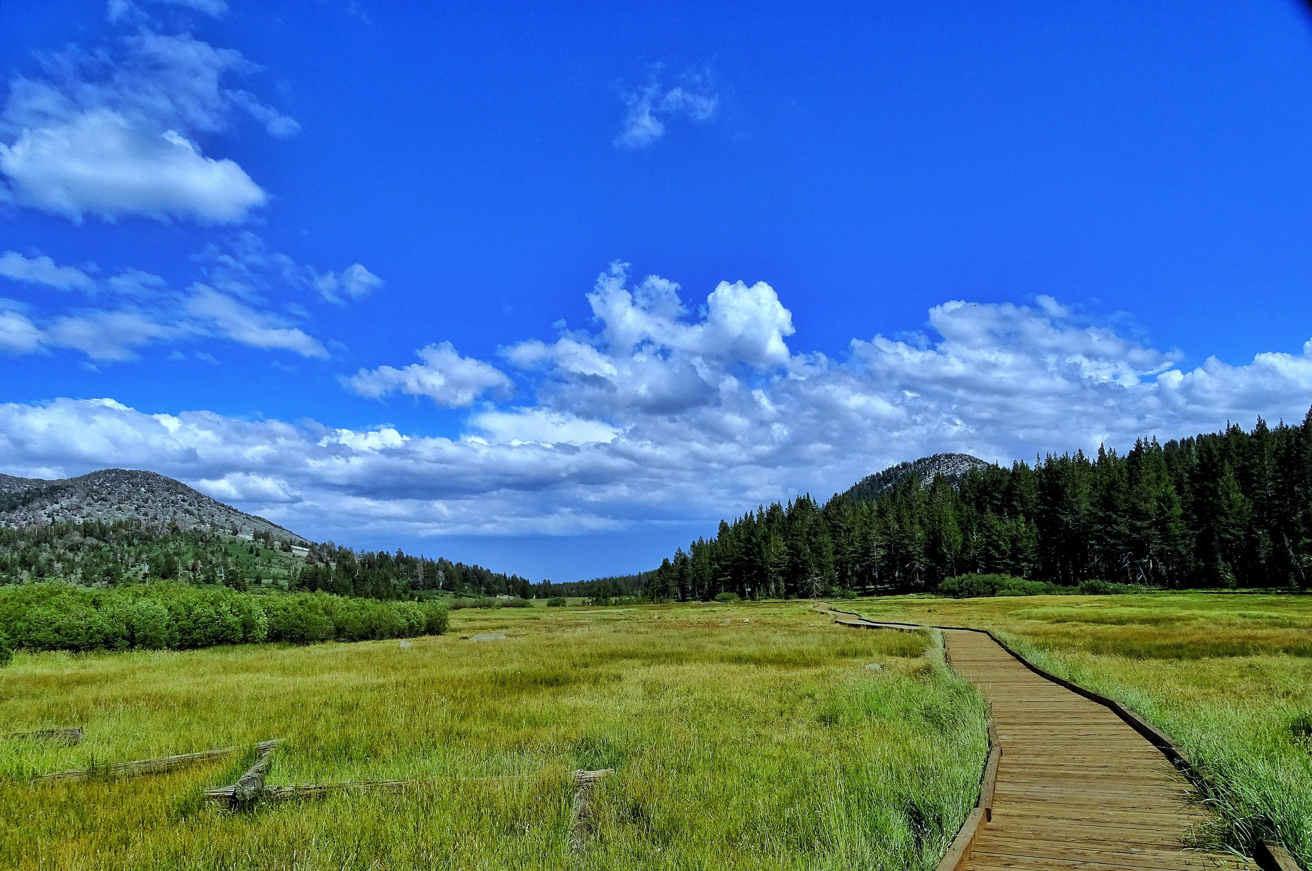
The Year Ahead 2024

Slide 14
2024 Key Goals
Implement regionalized dispatch/EMS/fire services
Complete West Hills refurbishment and open the facility for mental health services
Take leadership role in Behavioral Health Administration for the region
Expand and improve senior services and facilities
Conduct secure elections (Presidential Preference Primary, Primary, General)
Engage in Fiscal Equity analysis with Cities of Reno and Sparks
Identify A New Courthouse Solution
Develop Funding Plan for WCSO Infirmary

Slide 15
Citizen Advisory Board Summary

Slide 16
CABs – Statistics & Promotion
CAB Stats 2023 (not unique individuals)
733 total staff/presenter/board participation in 2023 (hereafter called “staff”)
561 in-person participants from the community and 277 online, for a total of 838
Warm Springs CAB had 4x as many staff than public participants
West Truckee Meadows/Verdi had twice as many staff than participants
North Valleys: 122 staff versus 78 participants
A few CABs had approximately equal numbers of staff to participants for a 1:1 ratio
One of the more successful CABs, in terms of attendance, is Incline Village/Crystal Bay with 212 public participants and 103 staff, a nearly 2:1 proportion
Topic-based meetings are well-attended
One Gerlach meeting had nearly half of the entire year’s attendees in one meeting
More than half of the Spanish Springs CAB public attendees participated in 2 hot topic meetings: Lands Bill, Secretary of State
Promotion of the CAB
Each CAB meeting is promoted to the district list(s) it falls within, posted on Nextdoor, and is placed on the Washoe County webpage – equaling thousands of people notified
The full list of annual scheduled meetings is available online
Postcards sent in 2022 proved to be ineffective at increasing attendance

Slide 17
CABs – Membership
CAB members have expressed frustration with:
Lack of action items
Not providing true advice to the county
Loss of development topics being brought in front of the CAB
Strengthen Staffing for Development Meeting/CAB Communication
Timing – earlier in the process
Specific to the development
No restrictive Open Meeting Law requirements – public comment
Record meetings and promises made are to be implemented into the planning process, well ahead of the final approval by the County
Everyone in the community will have an equal voice at Development Meeting versus a handful of appointed CAB members

Slide 18
CABs – Survey
Community Survey
From June through September, Washoe County surveyed the community to ask about engagement
How do you want to hear from the County?
How do you want to communicate to the County?
Nearly 2,000 people took the survey
How Survey Respondents Prefer to Communicate With The County:
More than half of respondents prefer to visit the Washoe County webpage, followed by news sources.
Only 9% responded that in-person meetings were their first choice for hearing from the County
41% of people said in-person meetings are not useful
21% of people said in-person meetings are useful

Slide 19
CABs – Looking Forward
Community Outreach Based on Advisement in 2024
What Are Your Thoughts For CAB Improvement?

Slide 20
Thank you!

