Slide 1
Truckee Meadows
Public Lands Management Act

Slide 2
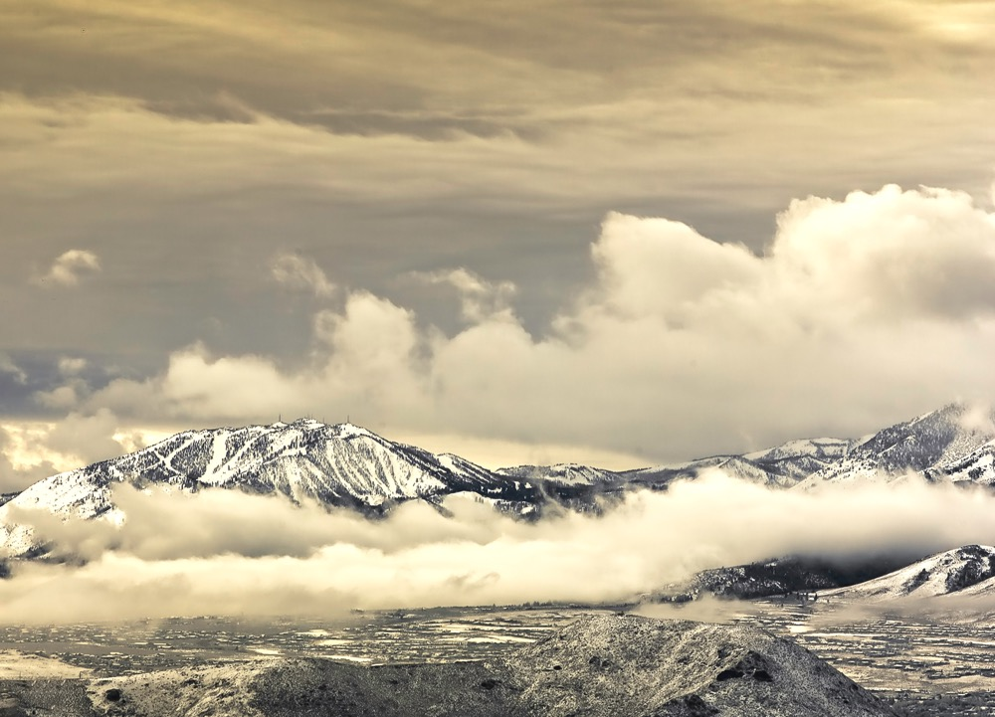
“To provide for economic development and conservation in Northern Nevada, and for other purposes”

Slide 3
Why a lands bill?
Promote sustainable growth and economic development – the BLM’s Resource Management Plan for Washoe County is 20+ years old and doesn’t address the current needs of a growing community
Protect and preserve public lands including the designation of Wilderness Areas (223,109 acres), National Conservation Areas (456,292 acres), and Special Management Areas (36,405 acres); eliminate Wilderness Study Areas
Washoe County has nearly 600,000 acres of wilderness study areas managed by BLM in a limbo status – not permanently wilderness or available for multiple use
Wilderness areas can only be designated by an act of Congress
Support local Tribal communities
Expand land held in trust for the Reno-Sparks Indian Colony, Pyramid Lake Paiute Tribe, and Washoe Tribe (22,415 acres)
Establish a Cultural Heritage Area to permanently protect thousands of acres in the Pah Rahs to be co-managed by local Tribes and BLM (3,881 acres)
Provide local governments with lands for public purposes (4,701 acres)

Slide 4
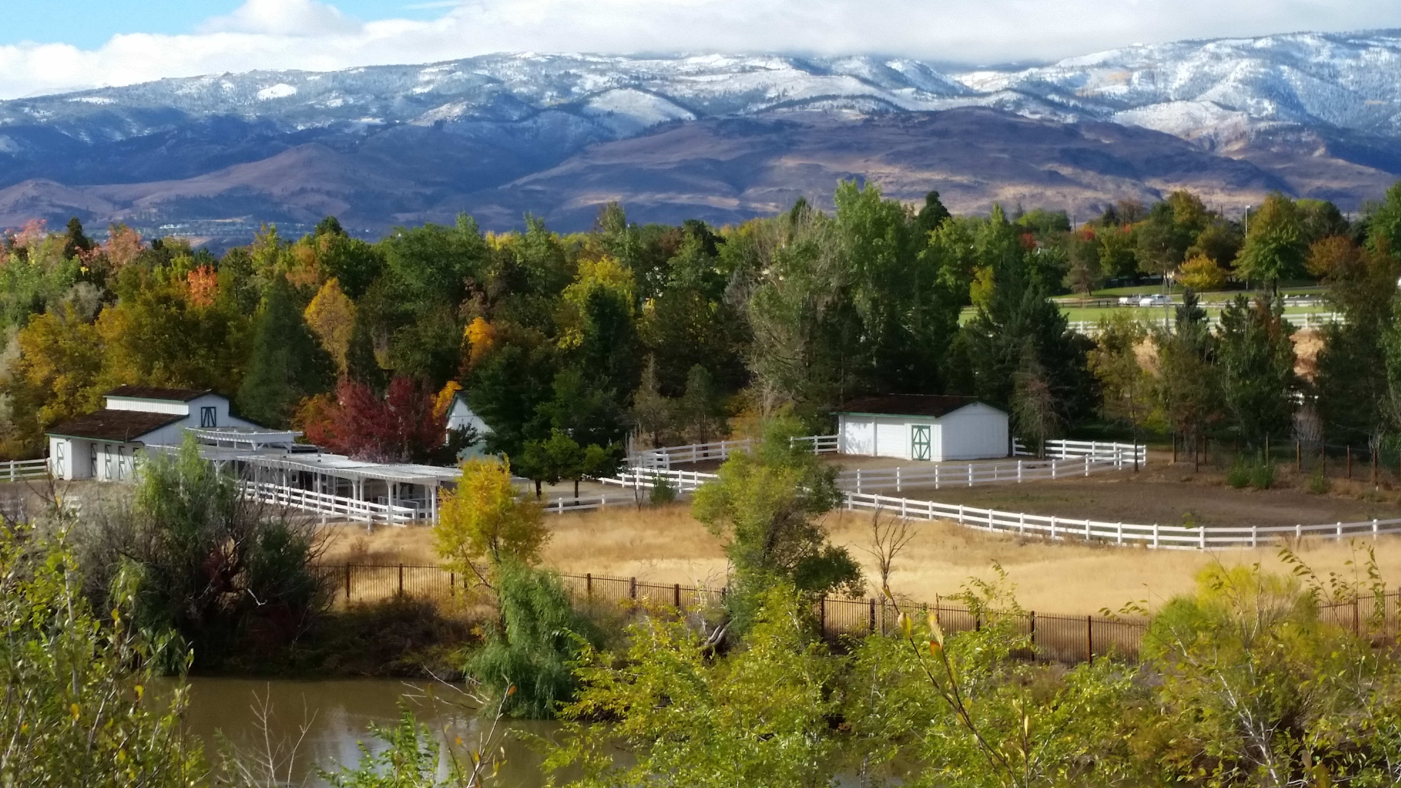
Categories
Conveyance to Local Government (~4,701 acres)
Washoe County - open space, trails, public shooting facility
City of Reno – parks, effluent storage, roadway expansion
City of Sparks - Parks, open space, cemeteries
University of Nevada Reno - UNR campus expansion
Nevada Division of State Lands – a State park
Incline Village General Improvement District - fire reduction activities and open space
Nevada Department of Wildlife – expansion of wildlife management areas
Truckee River Flood Management Authority - flood mitigation and scour protection
Washoe County School District - elementary & middle school site
Tribal Trust Lands (~22,415 acres)
Expand land held in trust for Reno-Sparks Indian Colony, Pyramid Lake Paiute Tribe, and Washoe Tribe

Slide 5
Categories
Disposal for Economic Development (~14,606 acres eligible to be nominated)
Must be nominated by appropriate governmental jurisdiction and must comply with all zoning and planning requirements (including TMRPA)
Must undergo appropriate federal environmental review
Must be sold for no less than market value and revenue to be divided:
5% to the State of Nevada General Education Fund
10% to the Truckee River conservation project fund
85% to the Secretary of the Treasury for parks/trails/natural areas, fuels reduction and wildfire prevention, conservation initiatives, acquisition of environmentally sensitive lands
Conservation Designation (~715,806 acres)
Grazing, recreation, hunting, and access continues within designated Wilderness Areas, National Conservation Areas, and Special Management Areas

Slide 6
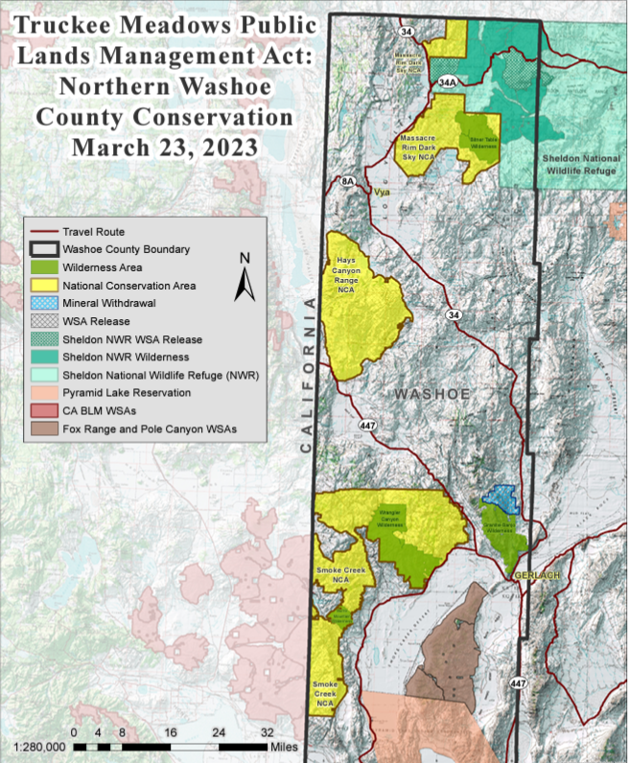
Conservation Designations
Wilderness Areas
National Conservation Areas
Special Management Areas
Cultural Heritage Areas
Grazing, recreation, hunting, and access to continue
Wilderness Study Areas - BLM identified as having wilderness character; must be protected until Congress decides whether or not to designate them as wilderness or release back to multiple use.

Slide 7
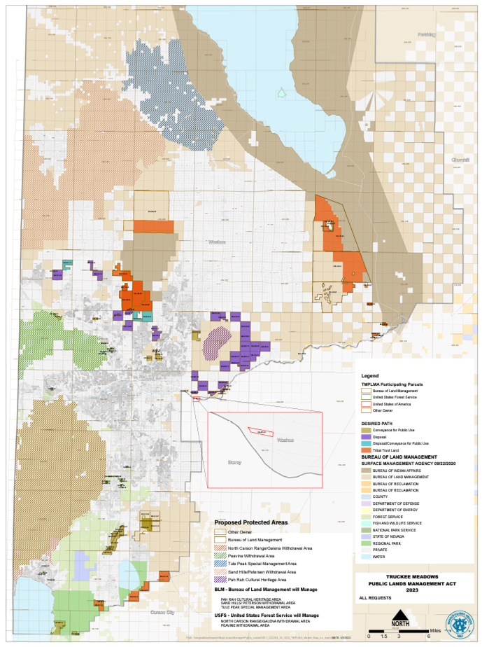
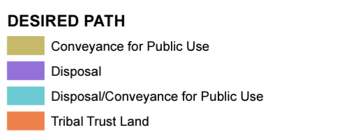
Disposal Areas
Conveyance to Local Govt.
Conveyance to all local government entities for public purposes = 4,701 acres.
Economic Development
Specific parcels of federal land would be eligible for sale and subsequent development, as appropriate, to support sustainable growth in the region.
14,606 acres would be eligible to be nominated for sale (differing from the SNPLMA model, this proposal does not include a disposal boundary)

Slide 8
Process
Truckee Meadows Public Lands Management Act
Draft bill text and map comment period complete (April 7, 2023 – June 6, 2023)
Resolution of support City of Sparks (passed July 24, 2023)
Resolution of support Washoe County (coming late August or early September 2023)
Coming Soon - Updated Maps and Language to address input from comment period:
Specific parcels to be added / removed for disposal and conveyance
Tribal trust land adjustments
Pah Rah Cultural Heritage Area boundary adjustment
Wilderness boundaries (including Fox Range and Pole Creek) and potential language changes for conservation areas
Bill to be introduced by Senator Rosen and NV Delegation (fall 2023)

Slide 9
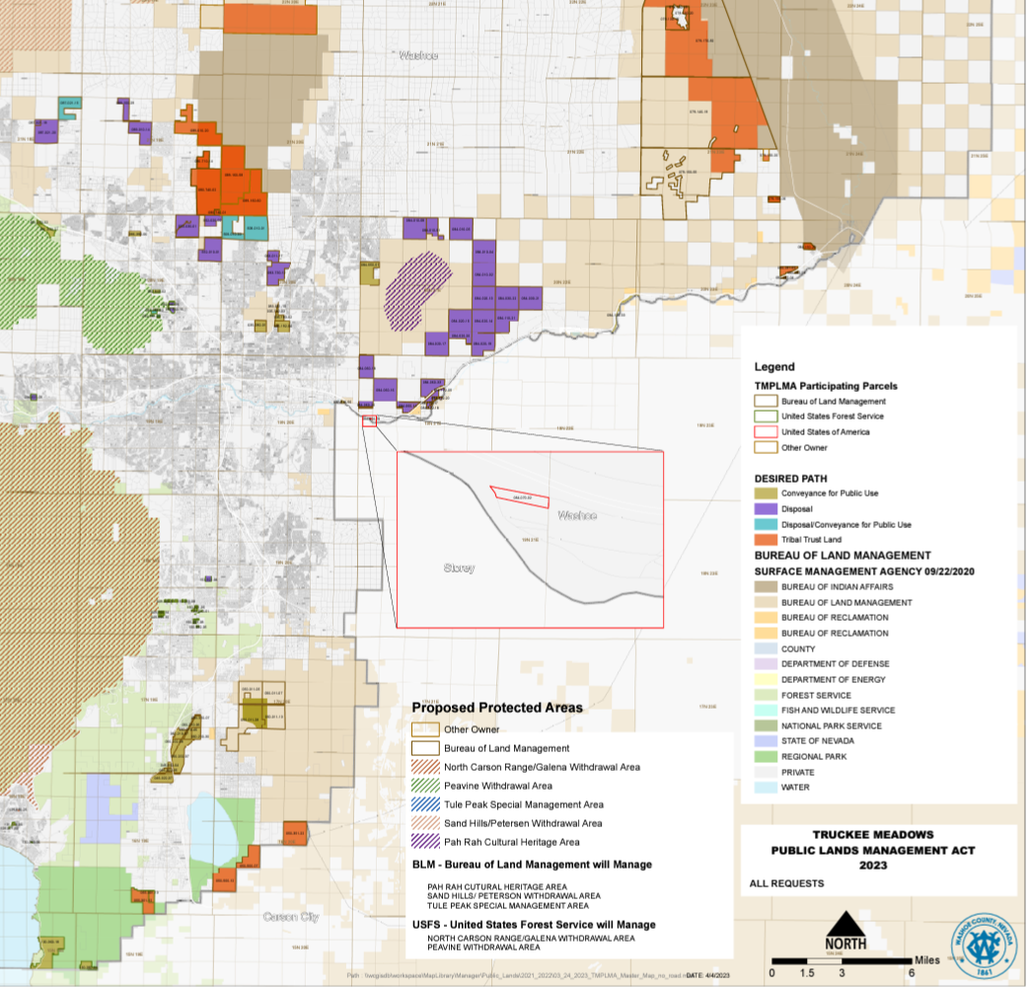
www.landsbill.org
Draft Language
Maps
Contact Information
Subscribe for alerts

