Slide 1
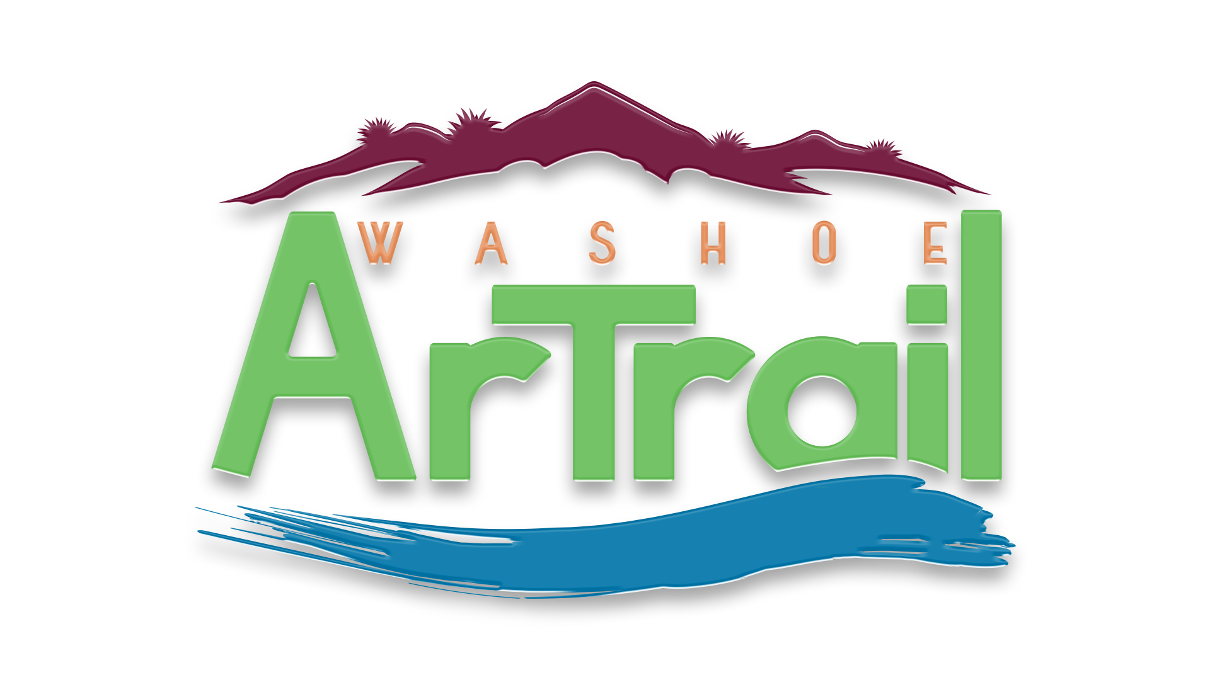
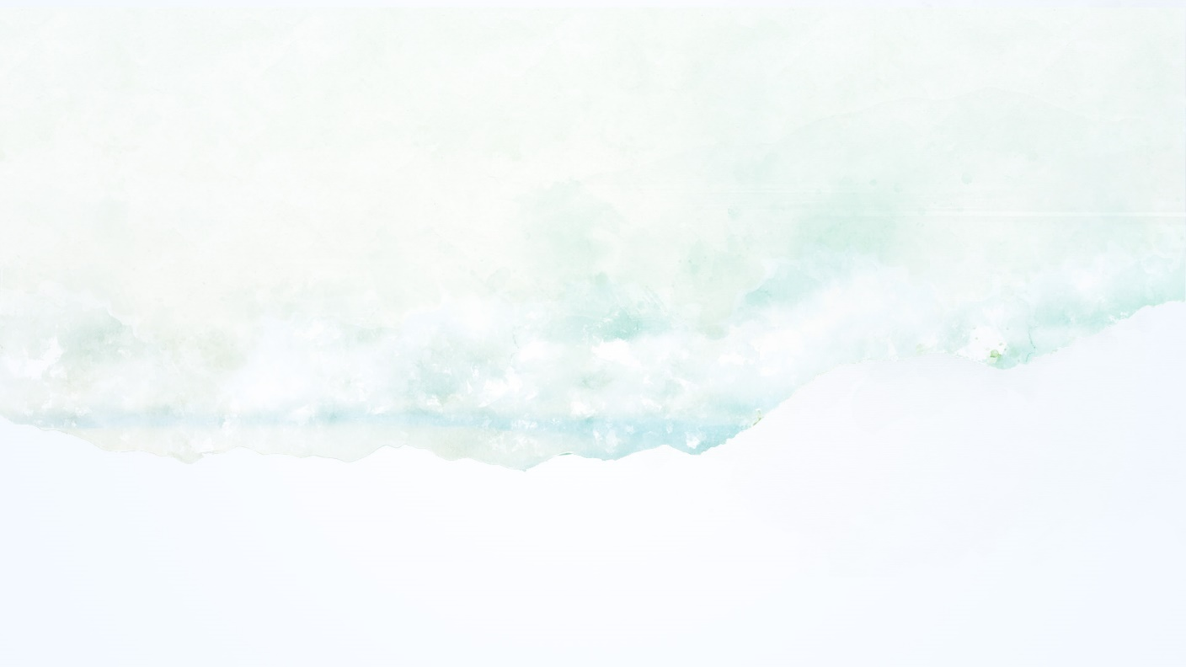
December 13, 2021
Notes:
Thank you for inviting us to share the Washoe Artrail with you.
We appreciate the opportunity to participate in your conference.

Slide 2
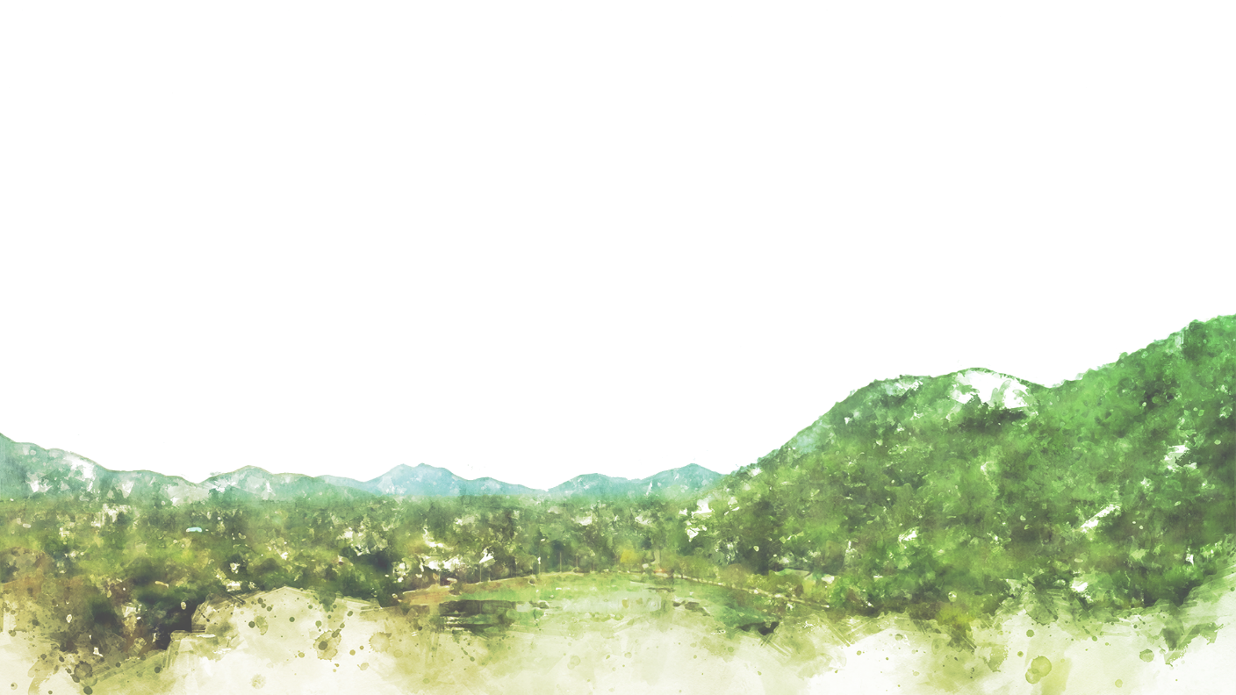
WASHOE COUNTY
Gabrielle Enfield, Community Reinvestment Manager
Notes:
WC Grants Administrator & Project Director for Washoe Artrail Project
I’ve been developing and implementing grants for over 25 years, and have carried out all types of projects from – Planning pjts, Social service, Housing, equipment and construction …
This is my first arts project. And definitely the most unique grant project so far. I love working for gov, and having the opportunity to do work that improves the quality of life. Working for government I never anticipated developing this type of project. Mojra and I will be tag teaming the presentation, please hold your questions to the end.

Slide 3
The Washoe ArTrail is a public participatory experience along a 200 mile route through Washoe County that celebrates cultural, historic and artistic landmarks.
Notes:
What is the Washoe Artrail?
Public Participatory Experience
Route – existing roads & paths
Cultural, Historic, Artistic landmarks. – too long name…..

Slide 4
WHY DEVELOP AN ARTRAIL?
Celebrate Unique Washoe County
Economic Development
Strengthen Community
Build on Arts Culture
Notes:
Unique natural environment,
rural, urban, tribal lands,
Sierra foothills, Truckee River, high desert, Pyramid Lake, Playa
Size and vast open spaces. - Washoe County covers 6,551 square miles
Economic Development
One of the primary issues we were seeking to address when considering the NEA Grant opportunity was economic Development for Gerlach and our rural areas.
The project will strengthening our community by encouraging people to visit and experience the beautiful art, cultural and historic places throughout our County; and better understand the places their neighbors call home. Many residents of Reno and Sparks have never been to Gerlach (100 Miles north or Reno), or know about Winnemucca Lake.
Build on our Arts Culture – City of Reno has been developing public art for years, Burning Man, is in our backyard, and has brought great art and artist to Washoe County. Sparks is also beginning to prioritize public art and is working to bring more art to the community. This project builds on this foundation.

Slide 5
HOW IT CAME TOGETHER:
National Endowment of Arts - Our Town Grant
Burning Man Project – Arts Organization partner
Stakeholder / Partner support & commitment
Washoe County support & commitment
Notes:
NEA – Our Town Grant Program is focused on Placemaking-
Placemaking is a multi-faceted approach to the planning, design and management of public spaces. Placemaking capitalizes on a local community's assets, inspiration, and potential, with the intention of creating public spaces that promote people's health, happiness, and well-being.
Government & Art/Cultural Partner Required. – ArTrail idea to Burning Man – meeting in Gerlach – coming off the Playa days before the BM Event in 2016. Received $75,000 Grant in fall of 2017.
Stakeholder and partner support and commitment…. Next slide
WC Support – More than14 staff working from throughout WC have contributed to the success of the project. BCC & County Manager support – Trolls..

Slide 6
WITH A LITTLE HELP FROM…
WC Parks & Open Space
WC Planning & Building
WC Public Works
WC Technology Services
GIS, APP & website development
WC Communications
WC Office of County Manager
Notes:
– Parks & Open Space – CPP Art site, signage consulting, Moon light walks & talks…..
Permitting, and Historic Preservation
Construction Project Management – Foundation,
Mapping, APP and Website Development
Getting the word out - Project & Events - Ribbon Cutting, Moonlight Walks….
County Manager – Project Management, signage, budget for footings etc…
Washoe County has contributed over $250,000 cash and staff time to date.

Slide 7
WITH A LITTLE HELP FROM…
City of Reno
City of Sparks
Pyramid Lake Paiute Tribe
Reno-Sparks Indian Colony
Washoe Tribe of Nevada and California
Gerlach General Improvement District
One Truckee River
Nevada Museum of Art
Notes:
These entities committed to participate at the beginning of project development before we submitted the NEA Grant & assisted us with multiple aspects of the project.
Identifying sites,
Reviewing and evaluating potential sites,
Site owners – committing to inclusion of specific sites on the Artrail
And
Artist evaluation
As we forward to working with more partners as we move into the next phase of the project.

Slide 8
PROJECT COMPONENTS
Create new Public Art – two trailheads
Crystal Peak Park & Gerlach Area – Phase 2
Identify existing sites along the route
Community Engagement (Story Circles & Engagement)
Washoe ArTrail APP, Website/Online Story Map
Interpretive Signage
Notes:
Our western trail head located at Crystal Peak Park. Crystal Peak is a 56 acre county park on the Truckee River. This park has a rich history and
Gerlach Area Phase 2 – comprehensive community process for the art to be chosen….

Slide 9
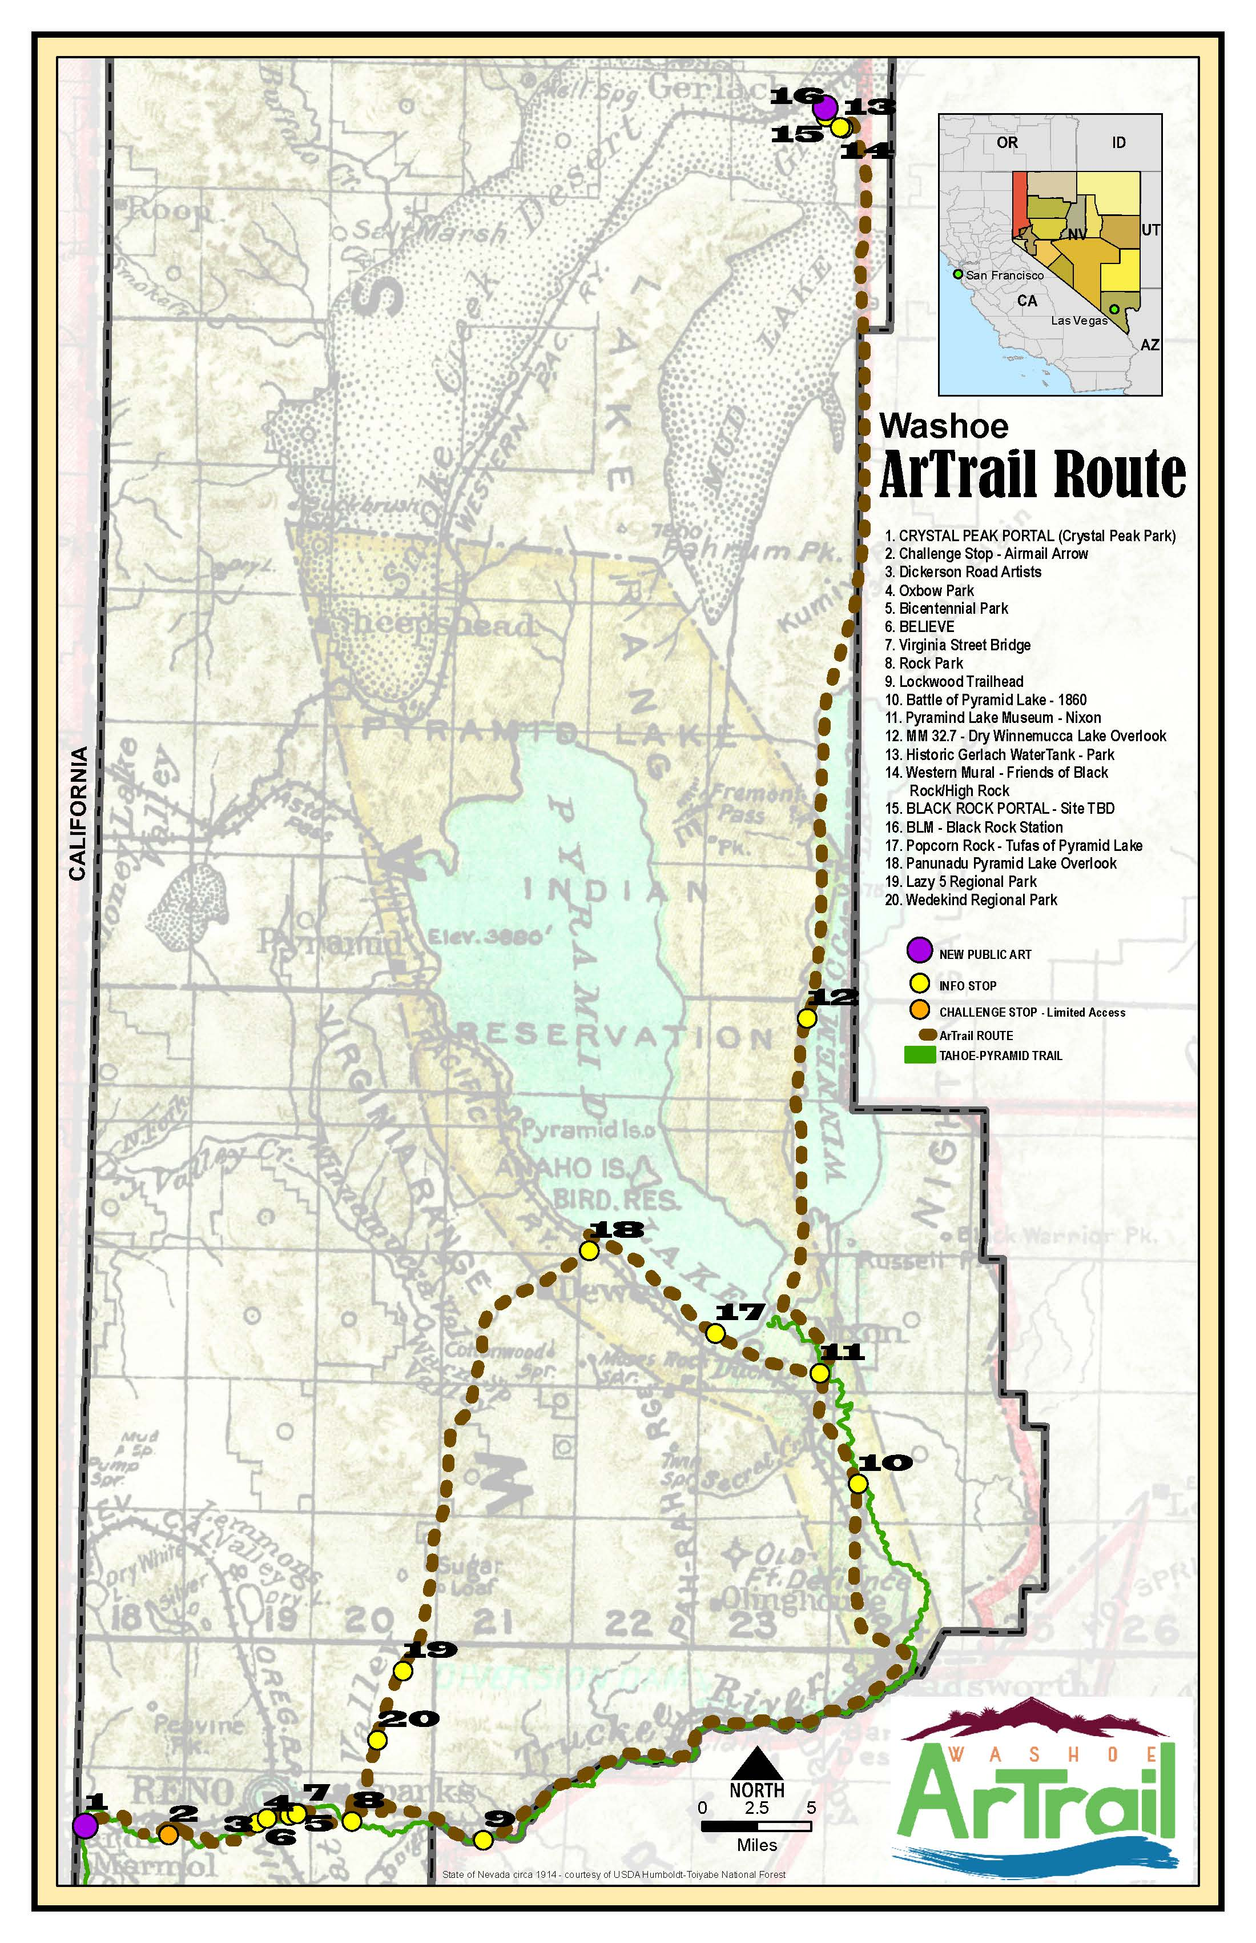
Crystal Peak Portal*
Steamboat Ditch Airmail Arrow
Dickerson Road Artists
Oxbow Nature Study Area *
Bicentennial Park*
BELIEVE
Virginia Street Bridge
Rock Park*
Lockwood Trailhead*
Pyramid Lake Museum
Winnemucca Lake View
Historic Water Tank*
Western Mural -Friends of Black Rock
Black Rock Station
Black Rock Portal **
Tufa’s of Pyramid Lake -Popcorn Rock
Panunadu Overlook
Lazy 5 Regional Park*
Wedekind Regional Park*
Notes:
Route – Verdi, Reno, Sparks, up to Pyramid, on to Gerlach back along Pyramid to the City of Sparks.
Identify existing sites – public input encouraged every opportunity of outreach, and partners.
8 sites located within Parks – Washoe County, City of Reno, City of Sparks, Gerlach GID. Expect trailhead to be a new park in Gerlach. & State of Nevada Historic Sites

Slide 10
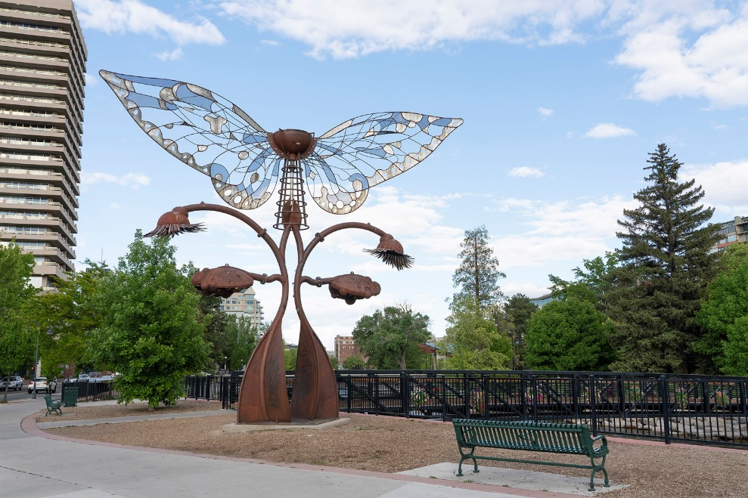
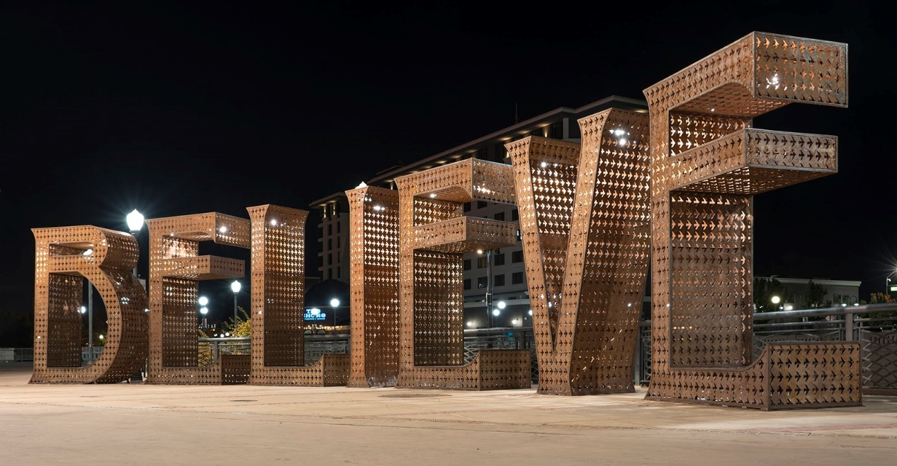
ART SITES
Notes:
Existing sites

Slide 11
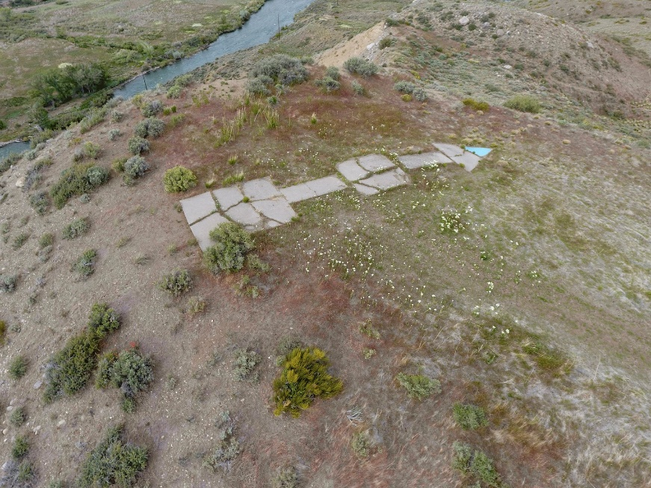
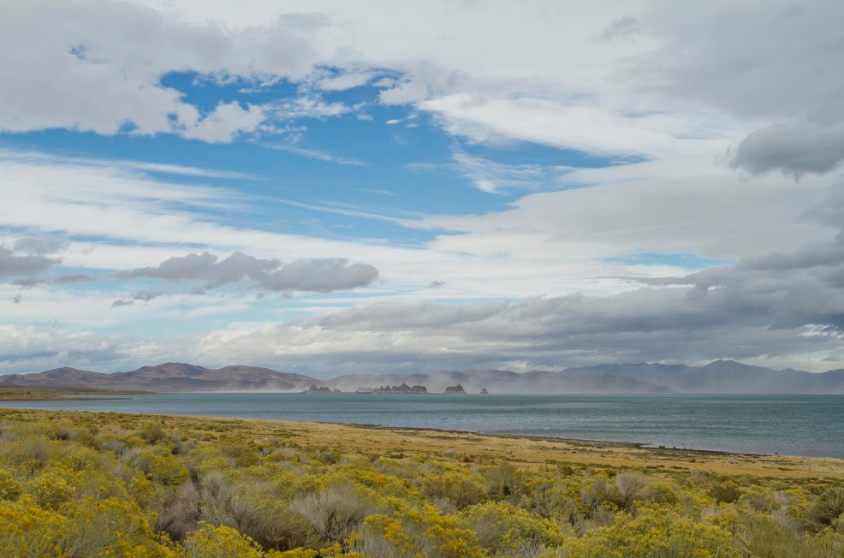
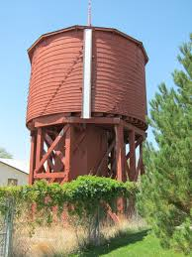
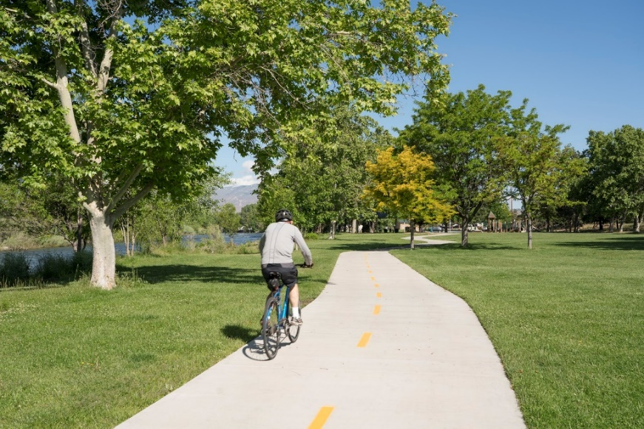
HISTORY & CULTURE SITES
Notes:
Much of the trail follows along the same route at the Tahoe Pyramid Trail – a hiking and biking trail. Over 50 miles of the Artrail is bikeable.

Slide 12
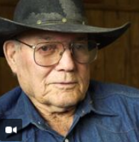
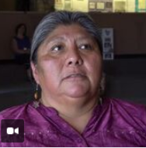
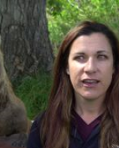
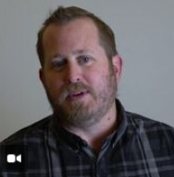
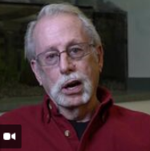
STORY CIRCLES
Notes:
Move to Story Circles Slide
Story Circles (Verdi, reno, sparks, pyramid, and Gerlach) on our webpage. Gather local histories and Inform the artist team about the places where our residents live.
Community Engagement –
discussions like today throughout the community. (Reno Arts Council, EDAWN Arts & Business Luncheon, tbd.) Gerlach K-12 Art work for APP…
Identifying existing sites to be on the trail.
Artown - July 16th and more to come…

Slide 13
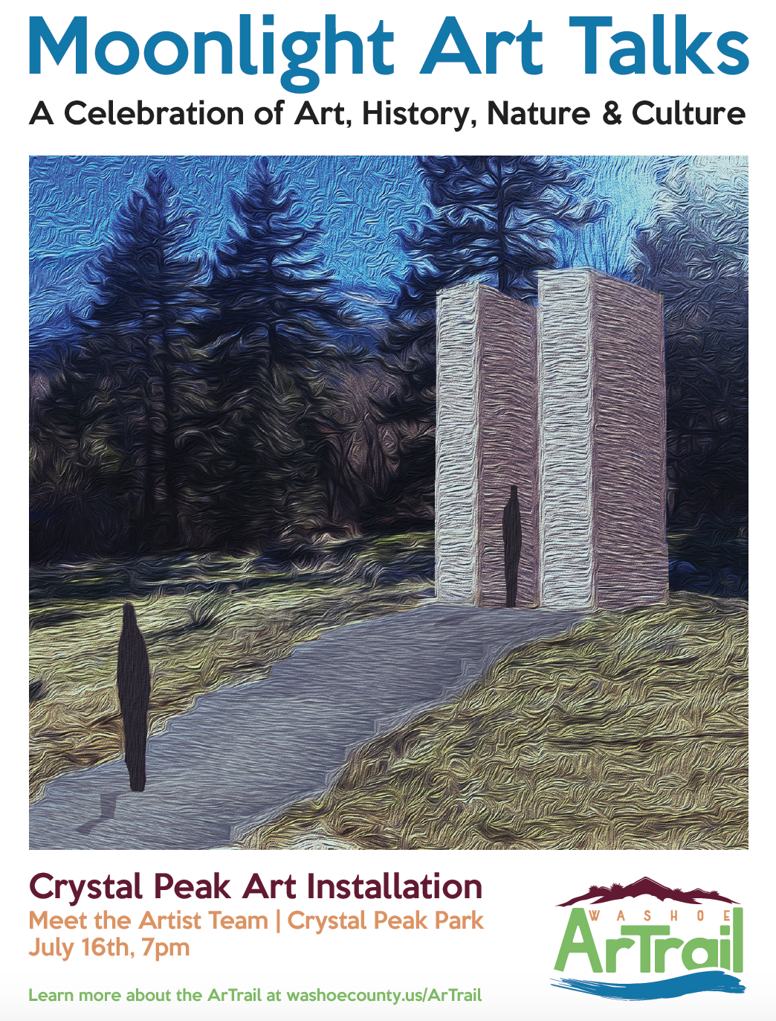
Storytelling Events
Ralph Burns, Neal Cobb, and others…
Moonlight Ranger lead walks
Community Meetings with the Artist team
Bike Tours along the Trail….
Notes:
To encourage community engagement we have held a few events, and are hoping add new events for additional locations throughout the trail.
-Story telling and moon light walk at Crystal Peak Park - July on the night of the full moon.
Past two years, very well attended

Slide 14
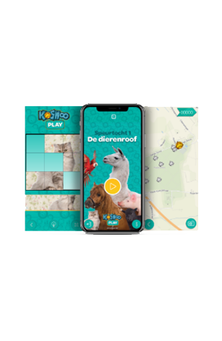
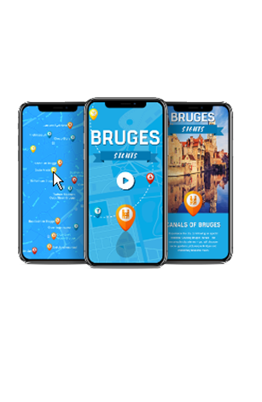
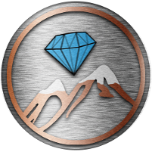
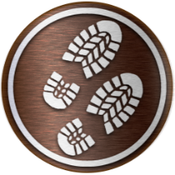
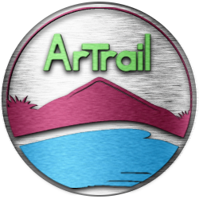
Treasure Hunts
ArTrail APP
Interactive Maps
Unravel digital stories full
Of exciting challenges
Tease visitors with images,
video and audio clips
Notes:
G--
APP slide-
Washoe Artrail APP & Website :
Interactive Maps,
Content – history, legends, stories, and
Games..
Washoe County TS developing the APP as well as the website in house.
Signup Sheet if you want to be put on an email list to receive notices events or key milestones.
Pass off to Joe Meschede my partner with the Burning Man Project.

Slide 15
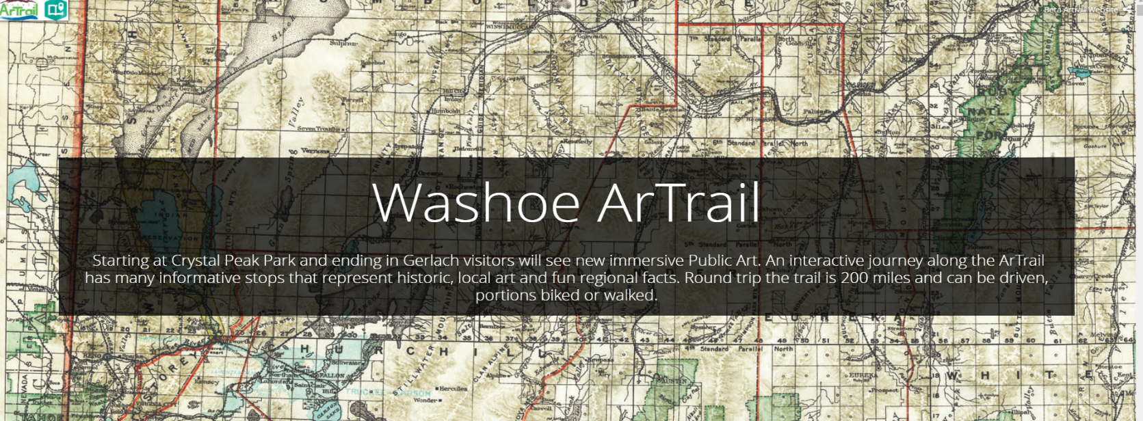
ArTrail Website

Slide 16
BURNING MAN CIVIC ARTS

Slide 17
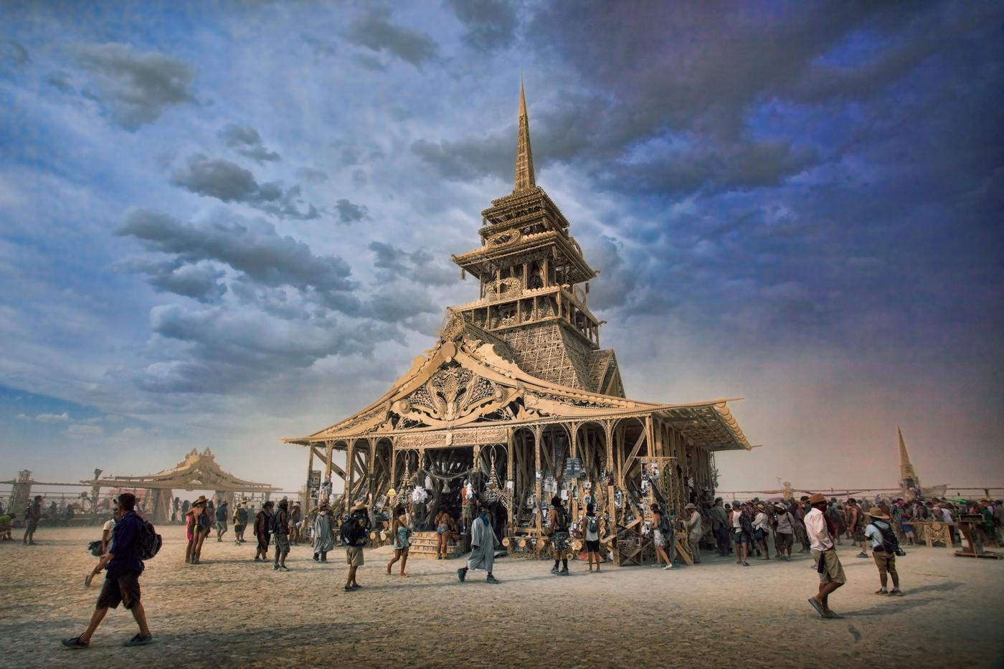

Slide 18
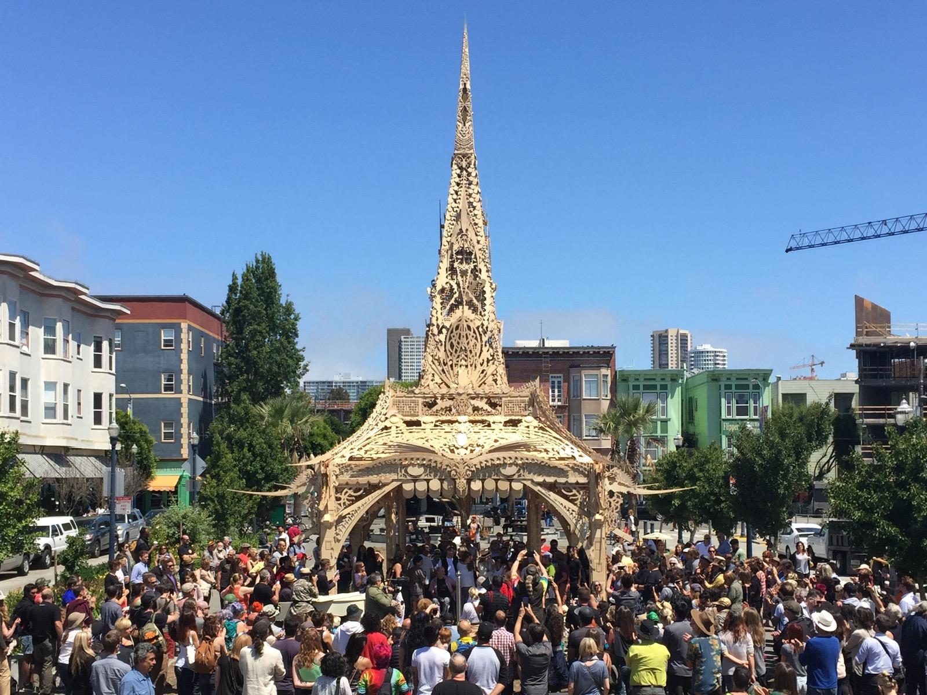

Slide 19
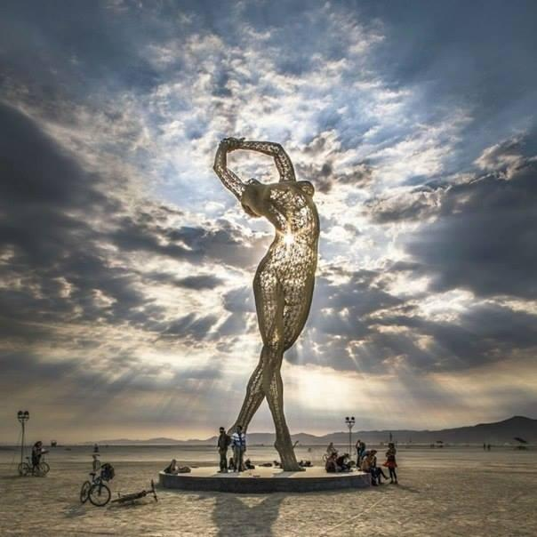
No Spectators: The Art Of Burning Man
Notes:
Traveling art

Slide 20
ROAM
ARTIST TEAM
Kerry Rohrmeier, PhD AICP
Jack Hawkins, AIA
Davey Hawkins, MFA
Scott Hinton, MFA
Notes:
Origin of how it came to be – Scott found it, Kerry forced everyone and woke to rammed earth, team Hawkins designed something beautiful

Slide 21
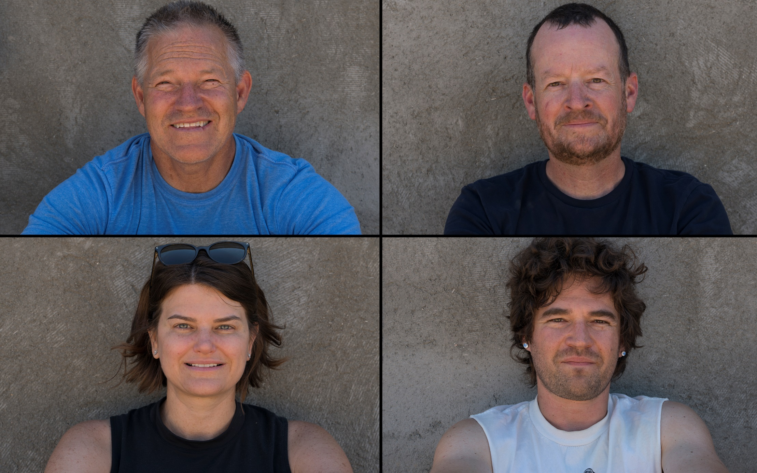
Notes:
Who we are:
Jack Hawkins – local award winning architect
Davey Hawkins – sculptor and musician, grew up in Reno works with the Minnesota Project in San Francisco
Scott Hinton – photographer at the UNR Department of Art
Kerry Rohrmeier – geographer earned a doctorate at UNR Department of Geography wrote a dissertation on the urban geography of BRC
Barbara Hatch – local landscape architect
Brett McElhaney – local structure engineer

Slide 22
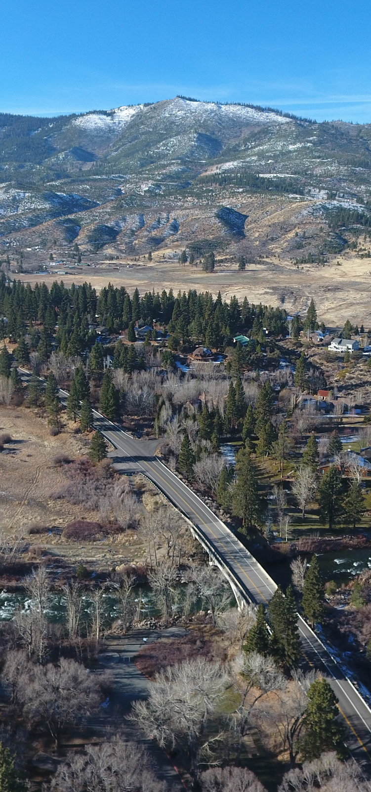
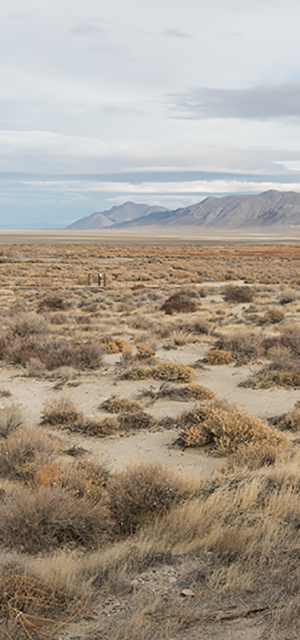
Crystal Peak Park, Verdi
Black Rock Desert
Notes:
Two trailhead sites
Our inspiration is really more about deep appreciation for the fragile Sierra and Great Basin ecosystems. We are anchored in this place as our home and are deeply committed to the Washoe ArTrail
Both portals will be sited to frame the alpine or playa vistas
The universal story of people and place especially here in the high desert is one of ephemerality.

Slide 23
CRYSTAL PEAK PORTAL
Notes:
Rammed Earth construction is one of the oldest building methods – examples in Sub-Saharan Africa, Middle East, even portions of the great wall
In simplest explanation term we are layering compacted soil in forms to get a desired form or shape
Color and striations give the effect of sedimentary rock
Sustainable, Lasting, Comprising Native Materials, Beautiful – much the way we view Northern Nevada and its future
It’s not a technique typically employed in Northern Nevada and we hope through this project and by offering a professional development training more people may consider it
We have complete a small test wall in midtown and constructed a larger porotype in Carson City
The construction took placed the second half of July with August

Slide 24
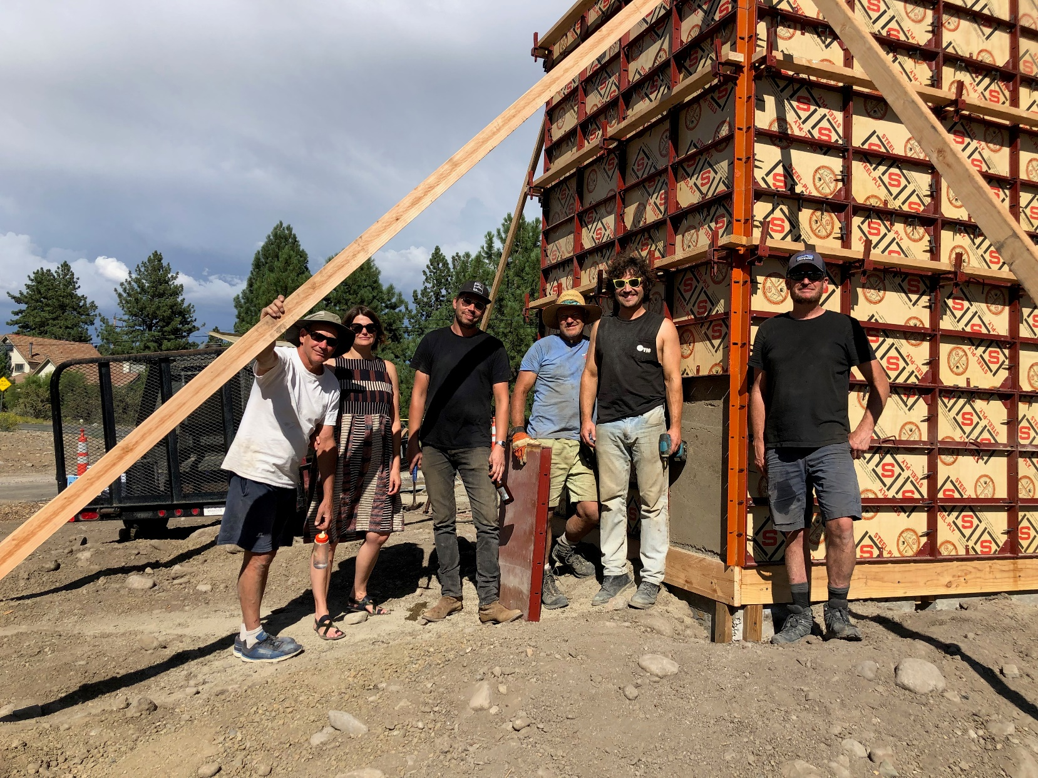
CRYSTAL PEAK PORTAL
Notes:
The Crystal Peak Park design is an 8x8 vault design that reaches 12’ tall with an opening for reflection. 18” thick
Sited to view the Sierra with a mirror floor to reflect the sky
Surrounded with riparian vegetation
Washoe County has generously aided us with site improvements – concrete footings - Time Laps Video---

Slide 25
CRYSTAL PEAK PORTAL
Notes:
Play time-lapse video

Slide 26
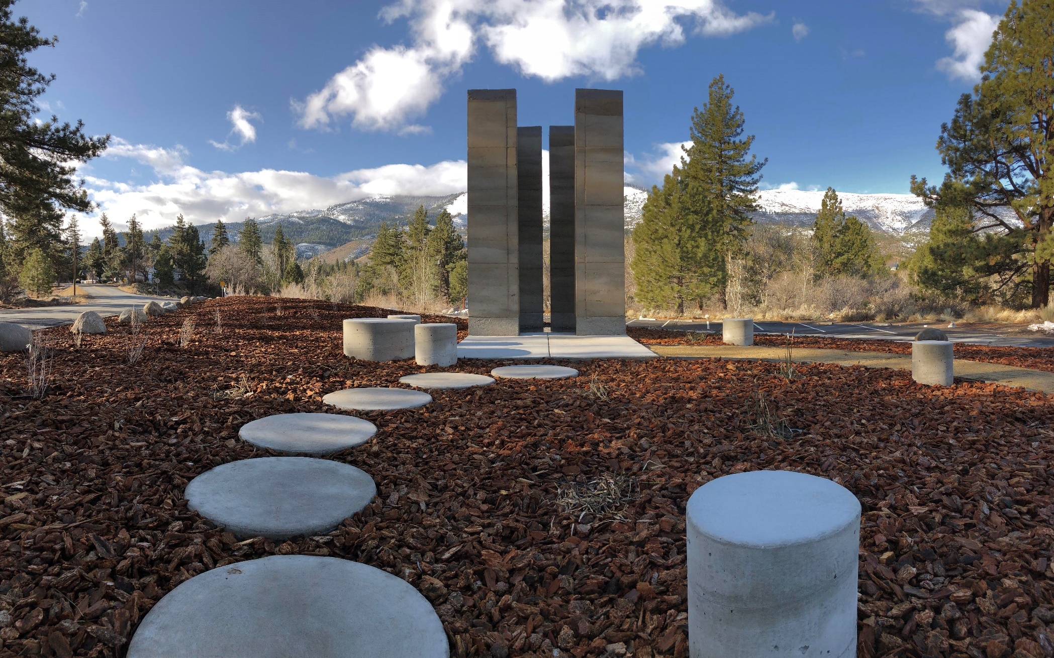
CRYSTAL PEAK PORTAL
Notes:
Finished Crystal Peak Sculpture.

Slide 27
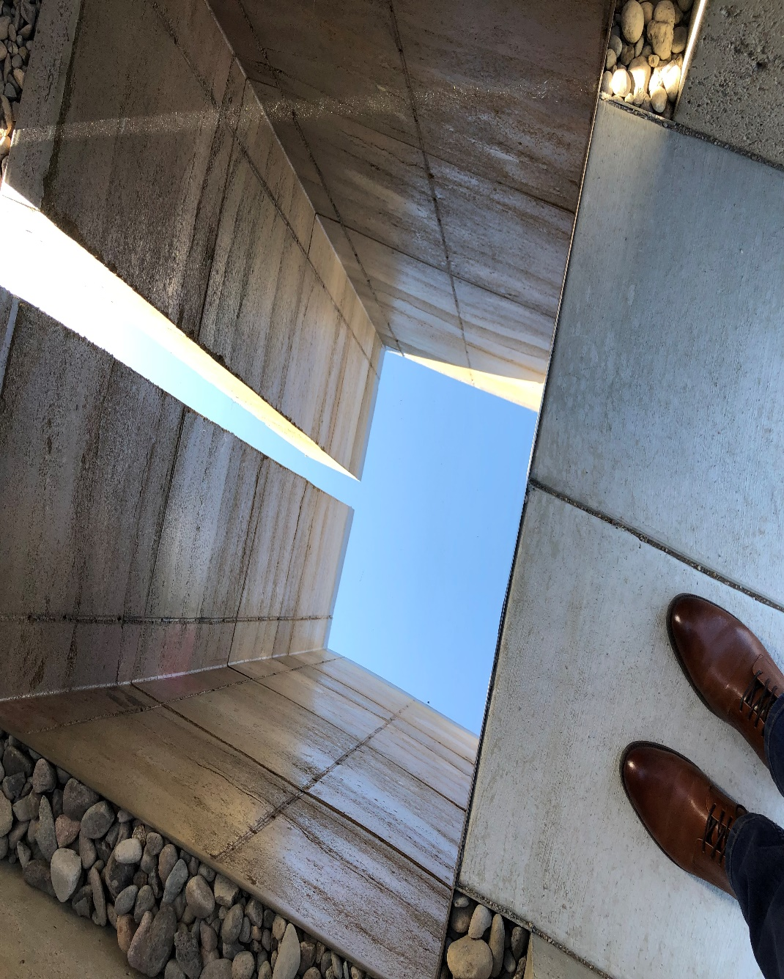
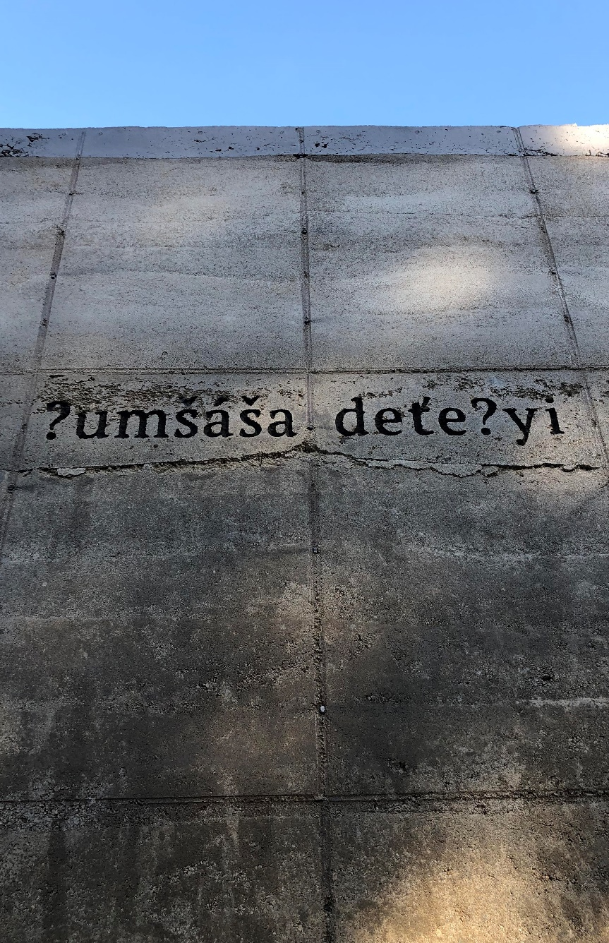
CRYSTAL PEAK PORTAL
Notes:
The Crystal Peak Park design is an 8x8 vault design that reaches 12’ tall with an opening for reflection. 18” thick
Sited to view the Sierra with a mirror floor to reflect the sky and surrounded with riparian vegetation
We are currently sourcing soils and have found a promising site in Mogul area. - update
These soils were tested for clay and sand composition. We added Portland cement for structural safety
We complete a small test wall in midtown and constructed a larger porotype in Carson City
We met with a member of the Washoe Tribe and embedded the Washoe place name into the work

Slide 28
Notes:
WC –
Inclusive – assets of our county - Arts, Culture, and History
WC’s first permanent public art
Large in scale – 200 mile route -rural, urban, Tribal lands
Public Participatory experience
App & Website to encourage participation across generations.
BM – perceptions, permanence
Washoe – Collaboration and partnerships, respect, process, flexibility. Build on Shared values and goals. (with all our partners)
Burning Man – Premier Arts & community experts with world wide community.
and ROAM chosen for the ART, got so much more . Digital Experience… Community Engagement….
BM – consensus building, community based
Roam – we are a new team, equal talents very different contributions, jump in
Question for audience breakouts and Reporting out.
If time allows we can answer from Washoe Artrail perspective
WC – Historic Preservation,- CPP multiple historic resources,
These type of grants are awarded for unique projects that break new ground, do something that has not been done before. With this type of a project there will be some: trail blazing, detours, and alterations along the way. Never a dull moment.
WC received NEA Our Town Grant for Artrail 2017, Sparks awarded Our Town Grant 2018 and Reno 2019 NEA grant.
I’d love to do another Our Town Grant – Community Engagement, and/or New Public Art. (NEPA & SHPO pre-Application)
BM – you don’t know what you don’t know
Roam – understanding scope, getting into an art project now considering this as architecture for community safety, hang on, PRACTICE

Slide 29
QUESTIONS?
Notes:
WC –
Inclusive – assets of our county - Arts, Culture, and History
WC’s first permanent public art
Large in scale – 200 mile route -rural, urban, Tribal lands
Public Participatory experience
App & Website to encourage participation across generations.
BM – perceptions, permanence
Washoe – Collaboration and partnerships, respect, process, flexibility. Build on Shared values and goals. (with all our partners)
Burning Man – Premier Arts & community experts with world wide community.
and ROAM chosen for the ART, got so much more . Digital Experience… Community Engagement….
BM – consensus building, community based
Roam – we are a new team, equal talents very different contributions, jump in
Question for audience breakouts and Reporting out.
If time allows we can answer from Washoe Artrail perspective
WC – Historic Preservation,- CPP multiple historic resources,
These type of grants are awarded for unique projects that break new ground, do something that has not been done before. With this type of a project there will be some: trail blazing, detours, and alterations along the way. Never a dull moment.
WC received NEA Our Town Grant for Artrail 2017, Sparks awarded Our Town Grant 2018 and Reno 2019 NEA grant.
I’d love to do another Our Town Grant – Community Engagement, and/or New Public Art. (NEPA & SHPO pre-Application)
BM – you don’t know what you don’t know
Roam – understanding scope, getting into an art project now considering this as architecture for community safety, hang on, PRACTICE

