Slide 1
AREA PLANNING in the Tahoe Region
An Informational Presentation
to the Incline Village Citizen Advisory Committee
January 3, 2023

Slide 2
ABOUT ME
Jacob Stock, AICP
Senior Long-Range Planner
jstock@trpa.gov
775-589-5221
Notes:
Been working as a planner for about 10 yrs
At TRPA for just 1.5
Focus on the Agency’s work on the code and regional plan
Generalist
Know a little about a lot. But can’t claim to know a lot about anything.

Slide 3
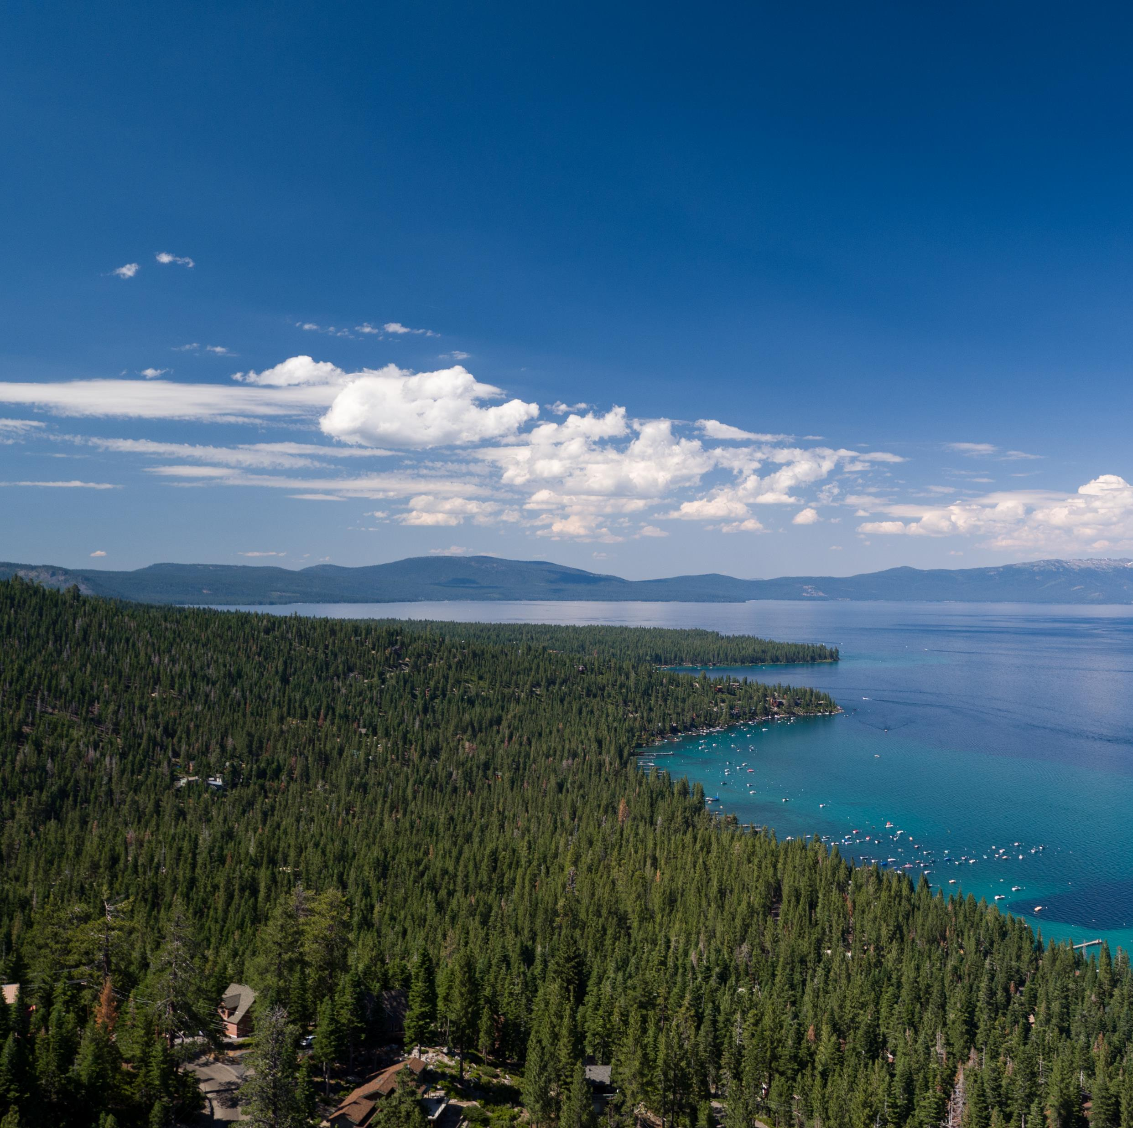
IN THIS PRESENTATION
The Tahoe Planning Framework
What is the Regional Plan?
What are Area Plans?
Washoe County’s Area Plan
Amending an Area Plan

Slide 4
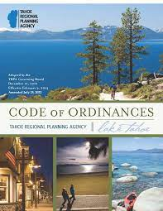
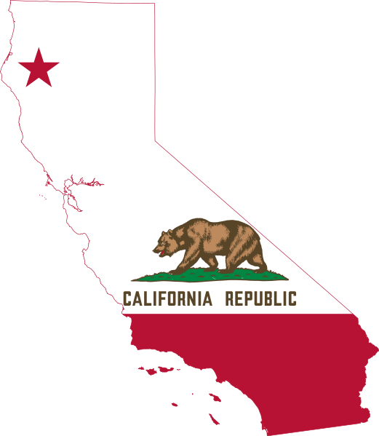
THE TAHOE PLANNING FRAMEWORK
Area Plan
Implementing
Regulations
Bi-State
Compact
Threshold Standards

Slide 5
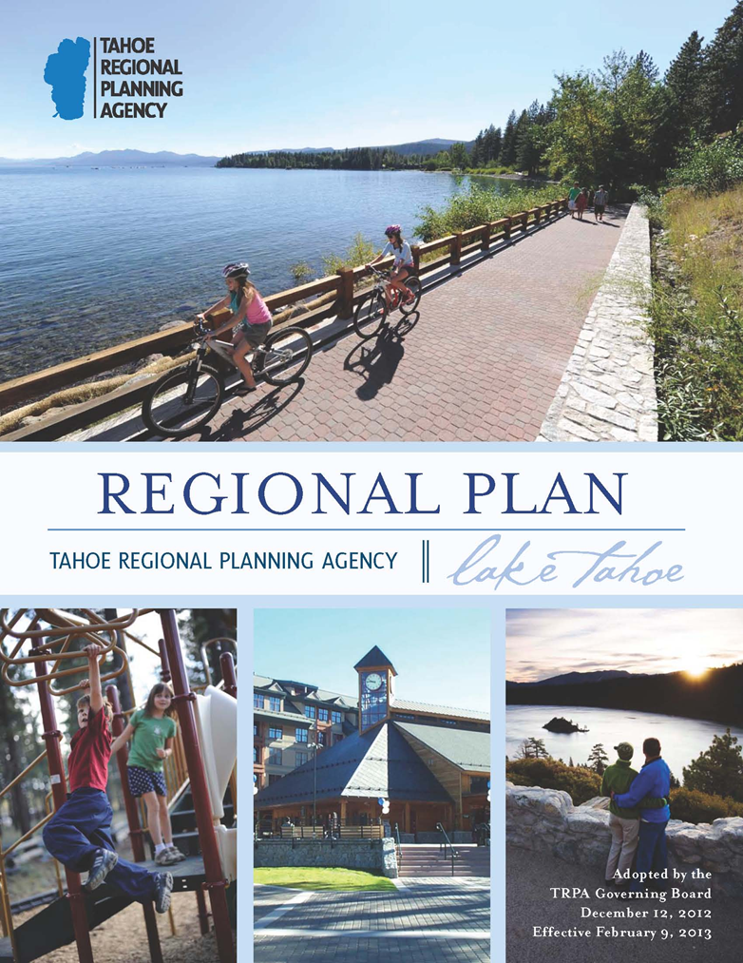
WHAT IS THE REGIONAL PLAN?
Adopted in 1987 and updated in 2012
The Tahoe Region’s guiding policy document
Aims to achieve and maintain the Region’s Threshold Standards
Sets development caps and mitigation for future development
Basis for regulatory code and other implementation tools
“The Regional Plan promotes environmentally friendly redevelopment of the aging built environment into compact, mixed-use development in town centers that connect residents and visitors to work, home, and the outdoors without the need for a personal vehicle.”
Notes:
Region almost built out
We know how much development potential is left
We set mitigation measures to ensure that remaining development potential

Slide 6
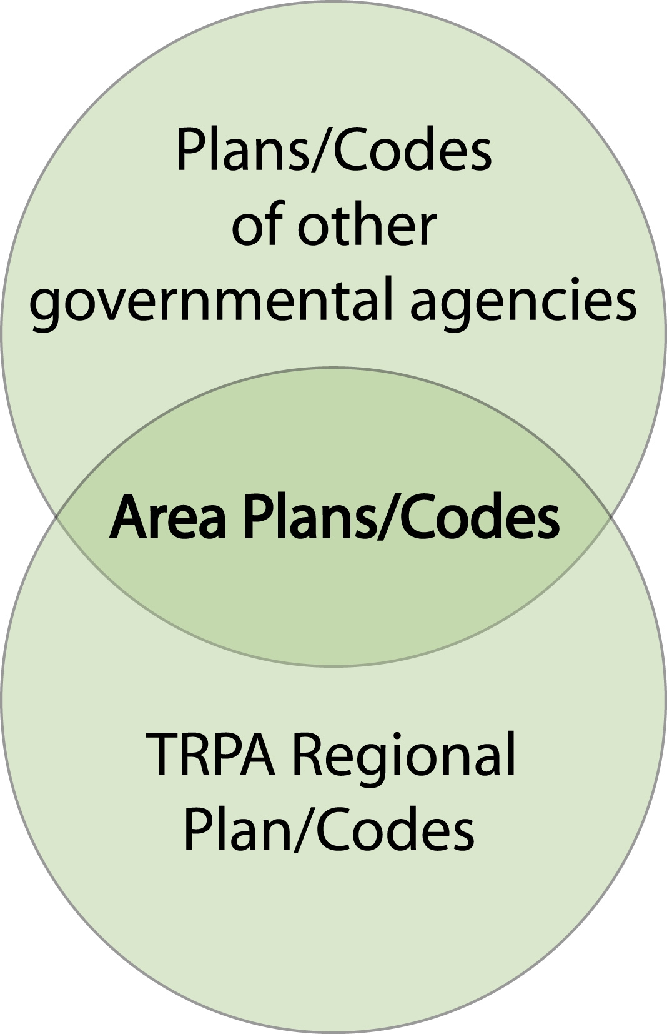
WHAT IS AN AREA PLAN?
Established with 2012 Regional Plan Update
Replaced Community Plans and Plan Area Statements
Allow local jurisdictions to define local policy and land use
Adopted into Regional Plan and Code
Include both policy and implementing regulations
Notes:
Area Plans are reviewed by TRPA for conformance with the regional plan but they are really meant to be owned by the local jurisdiction
This is why some of you have heard me say that Washoe County is driving the adoption process or amendment process and TRPA is reviewing
The ultimate goal is that the local government will take up implementation of their area plan through a permitting MOU
This is not TRPA giving up its responsibility to manage land use planning in the basin
Rather with the resources we have from the states and the complex regional and local issues we’re facing
It is more effective to strengthen our partnership with local jurisdictions and allow more autonomy in local planning (within the bounds of the regional plan) while focusing TRPA’s resources on regional issues
Tool for expediting threshold attainment
Projects still subject to appeal and large projects still subject to TRPA review

Slide 7
AREA PLAN MAP
Notes:
Will talk about importance of updating documents

Slide 8
WASHOE TAHOE AREA PLAN
Adopted Jan. 2021
Town Centers in Incline Village and Crystal Bay
Aims to manage development that:
Respects local heritage
Respects property rights
Provides a range of housing opportunities
Promotes educational and scientific opportunities
Addresses resource conservation
Promotes the goals of TRPA, Washoe County, and the community

Slide 9
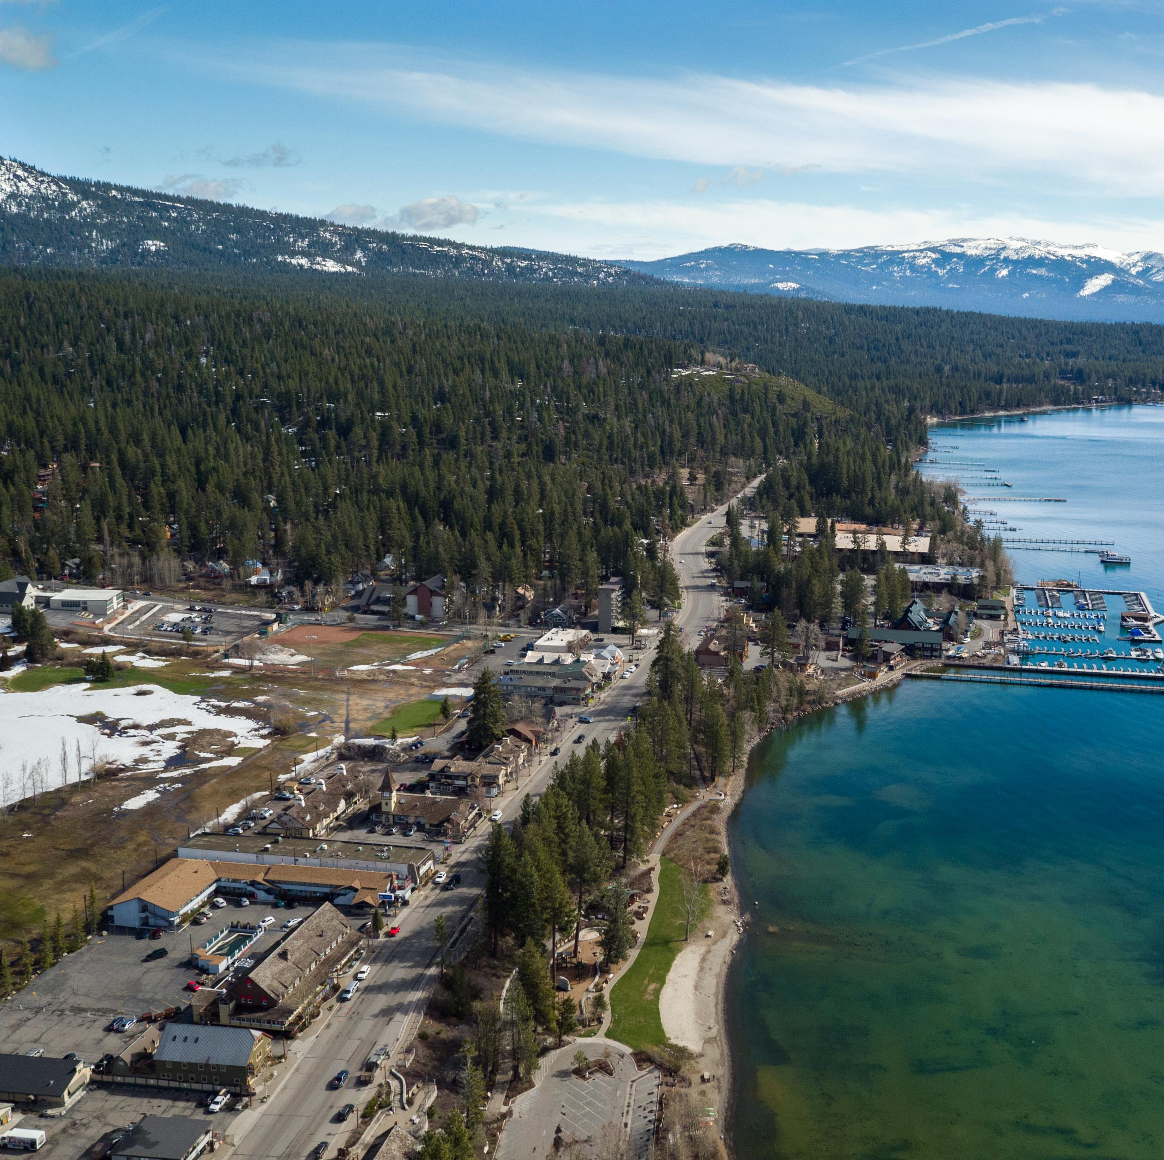
AMENDING AN AREA PLAN
Local jurisdictions take the lead in proposing and developing plan amendments
May choose to amend in response to:
Error in the original adopted plan
Comprehensive evaluation of plan performance
Emerging issues
New opportunities
Notes:
Area plans are not meant to be static documents

Slide 10
AMENDMENT PROCESS
Area plan amendments amend the Regional Plan
To amend an area plan jurisdictions must:
Submit a notice of intent to TRPA
Consult with TRPA staff on Regional Plan conformance
Submit supporting materials including:
Proposed changes
Initial Environmental Checklist
Area Plan Conformance Checklist
Compliance Measures Analysis Table
Written Findings
Staff Summary
TRPA staff review

Slide 11
AMENDMENT PROCESS CONT’D
Initiate local government adoption process
Provide informational presentation to RPIC before local adoption
Local adoption
Public hearing requesting Advisory Planning Commission recommendation
Public hearing requesting RPIC recommendation
Public hearing requesting Governing Board Adoption
Notes:
RPIC is Governing Committee

Slide 12
EXAMPLE AMENDMENTS
Douglas County:
An amendment to change religious assemblies from a special to an allowed use
Correcting an error in the original adopted plan
Placer County:
A comprehensive amendment supporting environmental redevelopment and affordable housing
Based on comprehensive evaluation of plan performance
Washoe County:
An amendment to allow condominiums in Incline Village Special Area-1

Slide 13
TENTATIVE SCHEDULE
January 17- BCC Second Reading
January 18- Draft packet due to TRPA staff
February 22- Informational presentation to RPIC
March 8- APC Hearing
March 22- RPIC Hearing
April 26- Governing Board Hearing
Notes:
Tentative schedule
Subject to change based on BCC direction or direction from TRPA leadership or governing board

Slide 14
GETTING INVOLVED
TRPA staff and Governing Board members are engaged and listening to the community
You may submit comments to Jacob Stock (jstock@trpa.gov) up to one week before a TRPA hearing for inclusion in the packet
All TRPA hearings are hybrid and include a public comment period

Slide 15
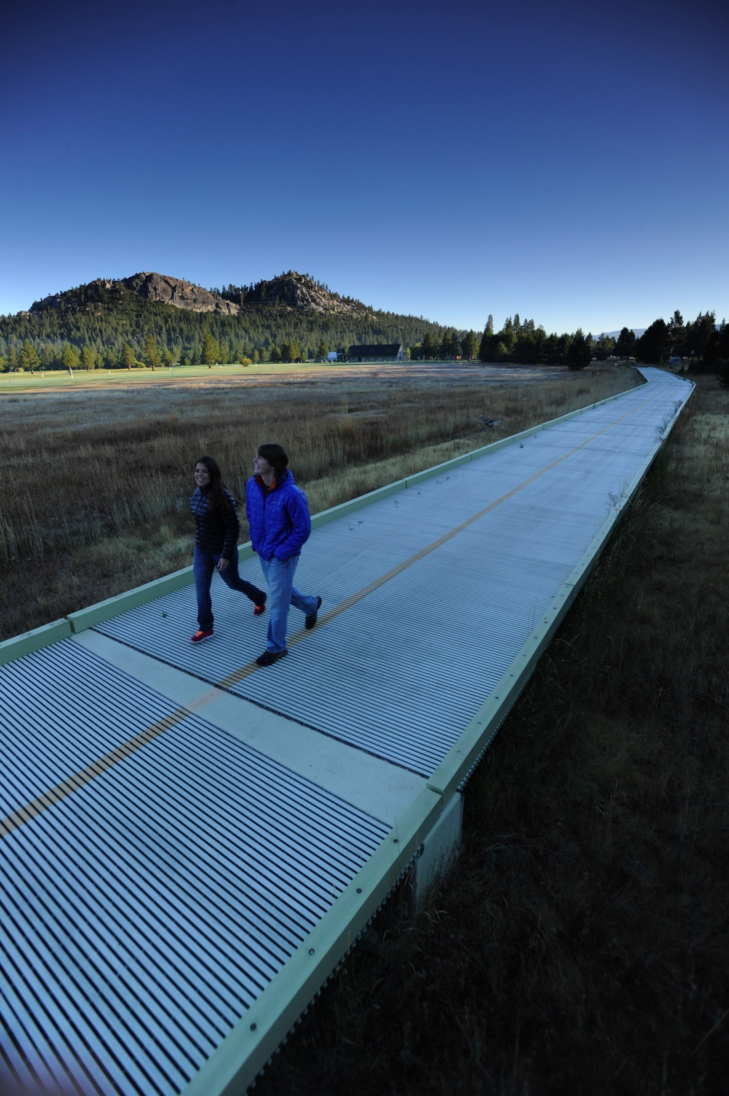
WHAT’S IN AN AREA PLAN?
Current Conditions
Conservation & Threshold Attainment
Land Use
Transportation
Recreation
Public Services & Facilities
Implementation, Development Standards & Design Guidelines
Notes:
Current Conditions – Describes existing environmental conditions, existing development, modes of transportation and service levels, public facilities and their service areas and capacities, and current implementation activities.
Conservation – Addresses water, air, land, cultural, scenic, and other natural resources, as well as attainment of thresholds required by the bi-state compact.
Land Use – Includes development constraints, and the types and amounts of different land uses, including physical development standards.
Transportation – Identifies the different modes of transportation used in the plan area, the levels of service, and planned changes in facilities and services.
Recreation – Identifies existing and planned parks, trails and other recreational amenities.
Public Services and Facilities –Addresses the provision of water, sanitary sewer, fire and police protection, telecommunications, and similar public services. Must be consistent with the land use element.
Implementation – Includes a link to implementing code, any applicable improvement programs (e.g., local government capital improvements program, the Environmental Improvement Program), and relevant operations and maintenance programs.

